Slide 1


AMIA 2024
Milwaukee
Thursday, December 5th
4:30 - 5:30 P.M.
Regency D
Morgan Oscar Morel
Video Lab Supervisor
Library of Congress
To Be Different
Demystifying Aspect Ratio and Forming a Community Consensus
Dave Rice
Archivist
CUNY TV
Notes:
Hi Everyone. My name is Morgan Oscar Morel. Dave Rice and I will be taking a deep dive into aspect ratio. This is a topic that Dave and I, along with many others in the field, have been mulling over for a while, so I’m really excited to present on it in front of all of you

Slide 2


PRESENTATION OVERVIEW
r
What do DAR, PAR, and SAR mean?
How do these concepts work in practice?
How do digitization tools implement these concepts?
Can archivists come up with our own best practices?
Notes:
Just a quick overview. I’m going to start by discussing definitions and how these different aspect ratio concepts work in practice. I’ll discuss what this means for digitization, all in the service of helping us archvists come up with our own best practices surrounding the topic.

Slide 3

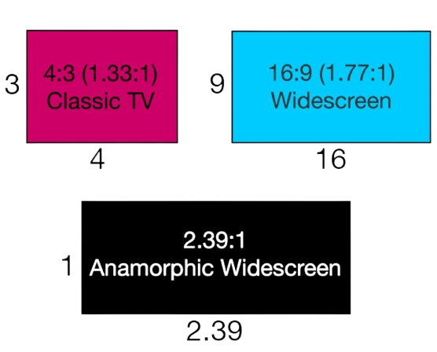
ASPECT RATIO BASICS
Image Courtesy of Vimeo
Notes:
First, I just want to give a quick overview of the concept of aspect ratio, which refers to the ratio between the width and height of the frame of an image. This concept is used in Video, Motion Picture Film, and Photography. Here are some common aspect ratios that appear in Video and Film. For the purpose of this presentation we’ll be focusing on how this concept applies to Video.

Slide 4
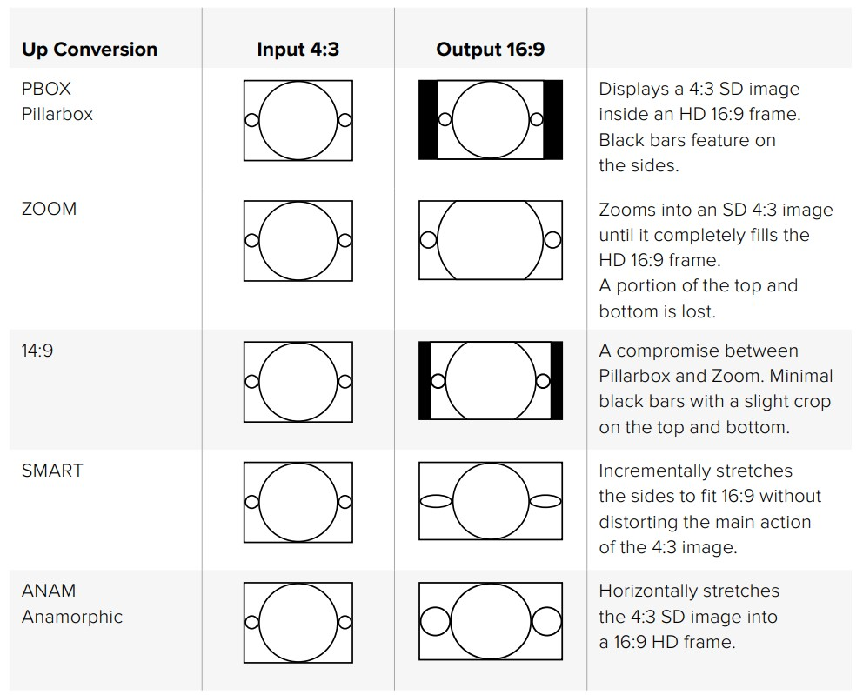
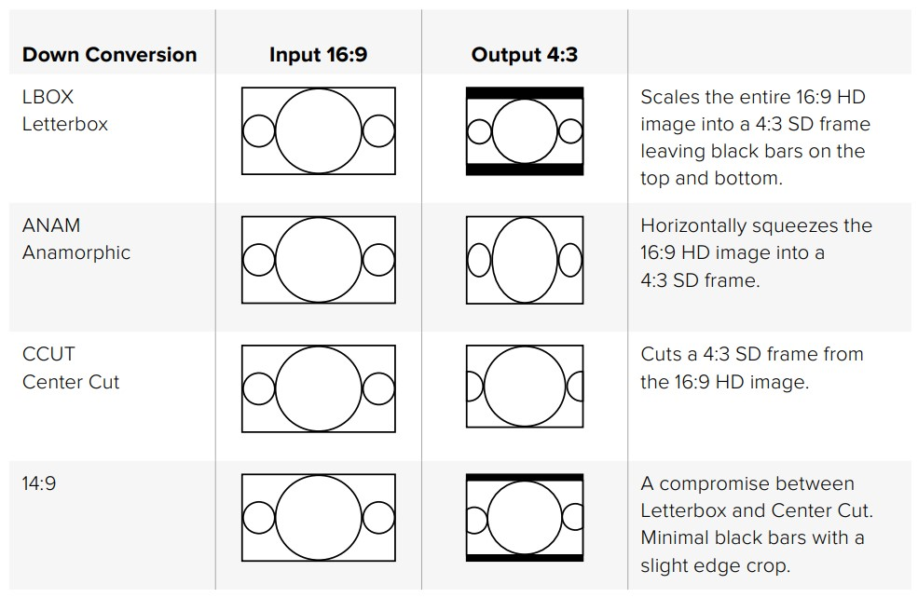
ASPECT RATIO BASICS
Image from BlackMagic Teranex Manual
Notes:
We won’t be discussing concepts like letterboxing, pillarboxing, stretching, cropping, and pan and scan in detail. These are methods that people use to take content shot in one aspect ratio and present it in another aspect ratio. Instead, this will be a discussion on the technical concepts surrounding aspect ratio in digital video.

Slide 5
From FADGI’S
Significant Properties for Digital Video
Display Aspect Ratio (DAR)
Pixel Aspect Ratio (PAR)
Storage Aspect Ratio (SAR)
DAR is the ratio between the width and height of the frame at the time of playback. DAR is a metadata field present in most audiovisual containers (though absent in some, including AVI) that is used by playback software and platforms to properly render the width and height of the frame proportionally so that the image is not stretched or narrowed.
PAR is the ratio between the width and the height of each individual pixel that makes up a video frame. Pixels within a frame are all of a uniform size, and while they may be square, they often are not. If the pixels are square, the PAR value is 1:1 or 1, since the width and the height of the pixels are equal to one another.
SAR is the width and height of a video frame expressed as a ratio. For example, a video frame with a width of 720 pixels and height of 480 pixels (720x480) would have a SAR of 3:2.
https://www.digitizationguidelines.gov/guidelines/sigpropvideo.html
Notes:
There are three major concepts that will be discussed. these technical concepts are definition by FADGI as such:
Display Aspect Ratio, Pixel Aspect Ratio, and Storage Aspect Ratio: DAR PAR SAR respectively.
DAR is the ratio of the width and height of a video at playback. This is basically what most people consider just plain Aspect Ratio. It’s the shape of the video when you see it played.
PAR is the ratio between the width and height of each pixel with the video. If a pixel is square, the PAR is 1:1, or 1. However, most of the time pixels are not square! we’ll discuss this a lot shortly
Storage Aspect Ratio is the essentially the dimensions of the video frame expressed as a ratio. If the video file were 720x480 then the SAR would be 3:2.

Slide 6

ONE QUICK CLARIFICATION
FFmpeg uses “Sample Aspect Ratio” in place of “Pixel Aspect Ratio”. Thus, FFmpeg uses SAR to refer to what most people call PAR.
Notes:
Before I go any further with this, I need to make a clarification. FFmpeg uses the term Sample Aspect Ratio in place of pixel aspect ratio. There is a good reason for this, and Dave will dive into this deeper during his portion of the presentation. However, this leaves us in a tricky situation, where S A R can mean two different things. When I speak I will do my best to say Storage Aspect Ratio instead of SAR or S A R, but please understand that this is a legitimate problem with definitions in the field!

Slide 7

PAR / DAR / SAR VISUALIZED
8
_
1
2
3
4
5
6
7
8
0.83
2
1
_
PAR = 0.83 / 1
or 5:6
5
3
4
5
PAR x SAR = DAR
5 8 4
SAR = 8:5
x =
6 5 3
Notes:
The concepts of PAR DAR and SAR can be hard to explain in situ, so I’m going to take some time to visualize them and show how they work together! Also, because of MATH the numbers can get pretty freaky. I attempted to simplify the math using smaller numbers, so these examples are meant to be simple, not indicative of real world examples. The MATH however does check out, which Dave made absolutely sure of. In fact, I screwed up the Math multiple times while working on this ha. Also, a quick explainer, a number with as bar over it means the number repeats to infinity. This is a way of expressing a fractional number as a decimal.
Ok, so let’s say you have a video frame that is 8x5 pixels. That would make the Storage Aspect Ratio 8 over 5
Now, if instead of square, the pixels were slightly narrow, where the width was about .83 the size of the height. This would make the Pixel Aspect Ratio 0.83/1, or ⅚
If we wanted to calculate the DAR of this file, we can use the extremely handy formula: PAR times SAR equals DAR. in this case, ⅚ times 8/5 equals 4/3. So, our DAR comes out a nice and familiar 4:3 aspect ratio.

Slide 8
PAR / DAR / SAR VISUALIZED
1
2
3
4
5
6
7
8
1
2
3
4
5
6
7
8
2
2
3
3
4
4
5
5
_
0.83
-
1.11
SAR = 8:5
PAR = 5:6
DAR = 4:3
SAR = 8:5
PAR = 10:9
DAR = 16:9
1
SAR × PAR = DAR
1
Notes:
Ok, that’s all well and good. However, what I really want to get to here is that you can actually have files with the same Storage Aspect Ratio, that is, the same dimensions, that have different display aspect ratios!
In this example we have two 8x5 video frames. They have the same Storage Aspect Ratio. However, they have different Pixel Aspect Ratios. The one on the left has a narrow pixel, where the width is less than the height, and the one of the right has a wide pixel. By using our handy formula here, we can calculate that the 8x5 frame on the right, with a Pixel Aspect Ratio of 10:9, has a display aspect ratio of 16:9.
So, we have two 8x5 files, but the different pixel width results in a different Display Aspect Ratio.

Slide 9
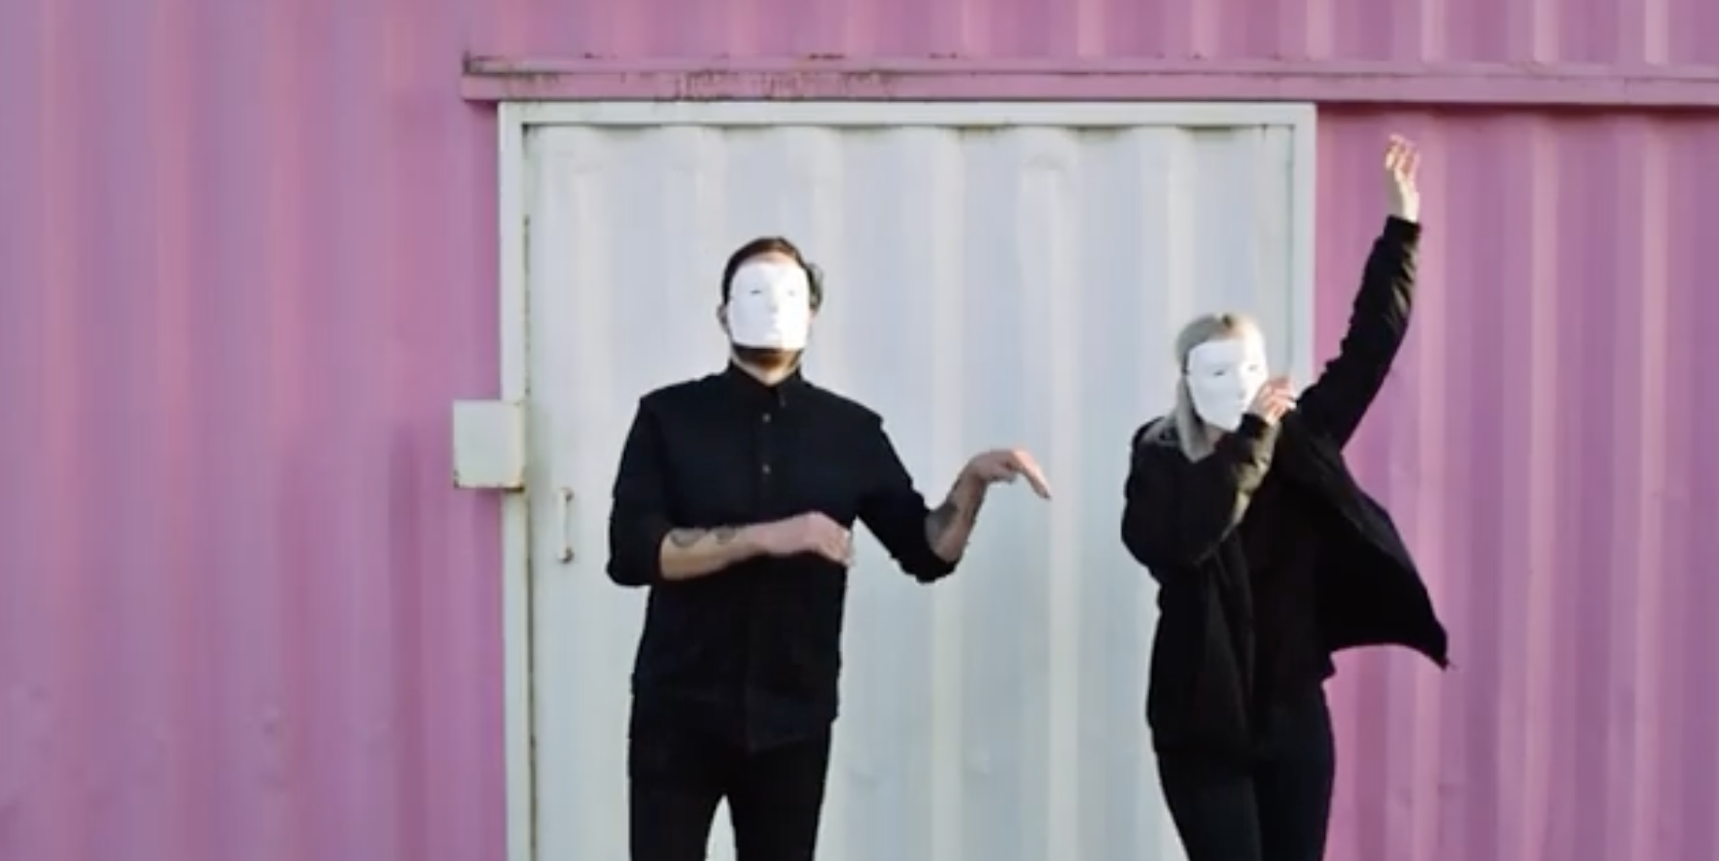
PAR / DAR / SAR VISUALIZED
1
2
3
4
5
6
7
8
1
2
3
4
5
6
7
8
2
2
3
3
4
4
5
5
__
__
0.90
1.21
SAR = 720:486
PAR = 10:11
DAR = 4:3
SAR = 720:486
PAR = 40:33
DAR = 16:9
1
SAR × PAR = DAR
1
Notes:
This is the kind of thing you’d see in a widescreen DVD or Digibeta tape. This is because NTSC video has a very specific frame size, which cannot be changed. The number of pixels is defined by specific standards, which we’ll talk more about later. Either way, since the number of pixels is defined, if you want to change the display aspect ratio of a video file, you actually need to change the width of the pixel, or the pixel aspect ratio.

Slide 10
PAR / DAR / SAR VISUALIZED
1
2
3
4
5
6
7
8
9
10
1
2
3
4
5
6
7
8
2
2
3
3
4
4
5
5
_
0.83
-
1.11
SAR = 10:5
PAR = 5:6
DAR = 16:9
SAR = 8:5
PAR = 10:9
DAR = 16:9
1
SAR × PAR = DAR
1
Notes:
But, just to show how these relationships work in theory, not so much in practice, we can see what would happen if we did add pixels to a frame. In this case we have those same pixels we were working with earlier, but have change the number of pixels.
The file on the left is 10x5, and the file on the right is 8x5. But the width of the pixel results in them having the same display aspect ratio. The file on the left has mode narrow pixels, the file on the right has wider pixels, but less of them. In the end both appear as a 16:9 video to the viewer.

Slide 11
CRITICAL TAKEAWAYS
SAR x PAR = DAR
DAR, SAR, and PAR are technical metadata fields within a file
The Storage Aspect Ratio (SAR) of a file cannot be changed
Pixel Aspect Ratio (PAR) can be adjusted to get your desired Display Aspect Ratio (DAR)
Notes:
So, just a few takeaways from this section: first is Display Aspect Ratio, Storage Aspect Ratio, and Pixel Aspect Ratio are technical metadata fields within a file. They are used for properly storing and playing back a file with proper geometric dimensions
Storage Aspect Ratio refers to the frame size of the video. this is not something you would generally change, since you cannot change the size of a video file without transcoding or damaging it in some way
Pixel aspect ratio however, can be adjusted. It’s metadata field that determines the width of each pixel in the video at playback. Adjusting the pixel width can be done to get your desired Display Aspect Ratio.

Slide 12
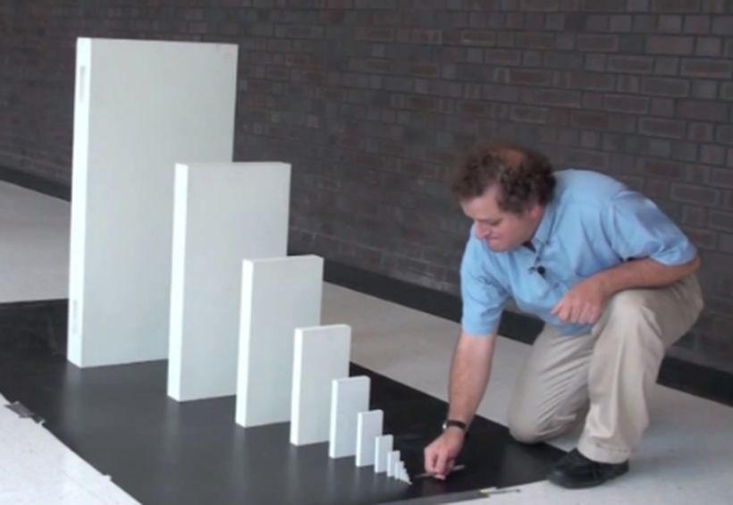
PAR is completely overhauled in vrecord
I couldn’t figure out how to export 4-Channel Audio from Premiere
Notes:
Ok, now a quick moment for story time. This domino meme perfectly illustrates how a technical issue that I was having led to the handling of pixel aspect ratio being completely overhauled in vrecor

Slide 13


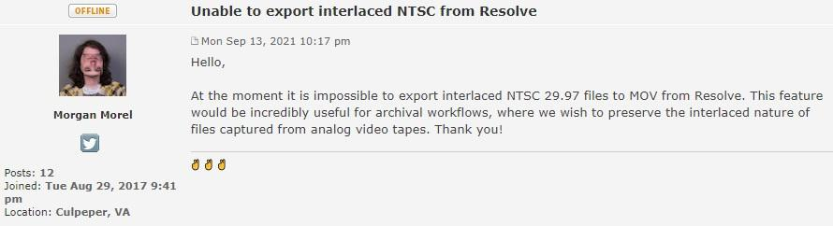
A short and simple request
Notes:
While working at BAVC I was trying to edit a 10 bit uncompressed video file with 4 audio channels. I couldn’t figure out how to properly export all 4 audio channels, so decided to try DaVinci resolve. Resolve properly handled the four audio channels, but wouldn’t export the file as interlaced. this presented a roadblock, so I decided to ask the Black Magic forums

Slide 14


THE CONVERSATION STARTED TO DRIFT
Why don’t you just use ProRes?
Why are you working with SD?
vrecord files have funky aspect ratio metadata?
Notes:
Everyone got really mad at me, asking my why I had to use uncompressed video instead of ProRes, or why I was using interlaced SD to being with. However, someone noticed some funkiness with the metadata in the files that vrecord was making

Slide 15
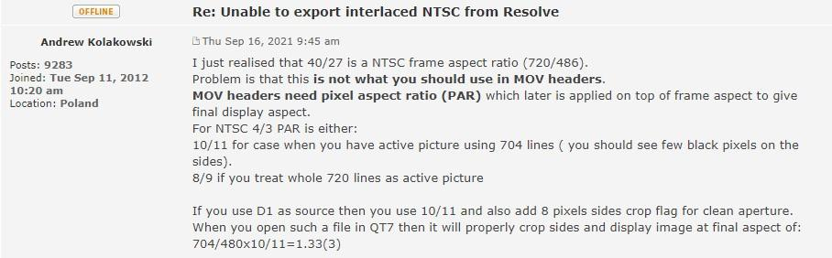
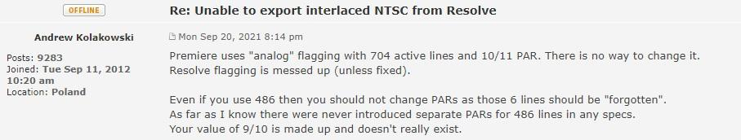
Andrew then figured out there is indeed an issue
Notes:
A guy named Andrew Kolakowski was really hung up about the fact that vrecord files were using a Pixel Aspect Ratio of 9/10, which he claims was made up and doesn’t really exist. Instead we need to be using 10/11 or 8/9, depending on how wide the active picture is. If this is confusing to you, then you’re normal! this really was a bit over my head at this point, so I ran with my tail between me legs over to the vrecord github

Slide 16
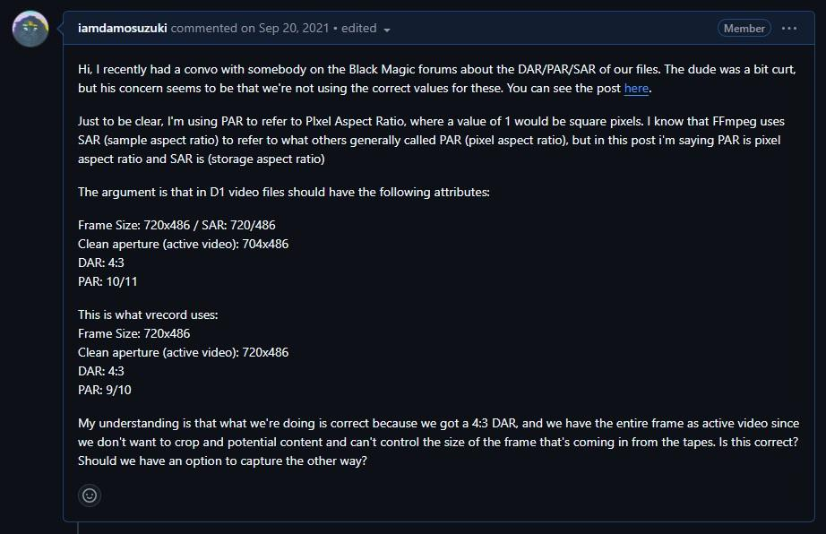
Notes:
On the github I made a post asking about this topic. Could we be using the wrong Pixel Aspect Ratio? were we totally screwing up these files?

Slide 17

Alex Habgood to the rescue
Notes:
Luckily, Alex Habgood came to the rescue with a link to article that dove deeply into the topic, which was available only via the wayback machine. Clicking on that link led me deeper down this rabbit hole

Slide 18
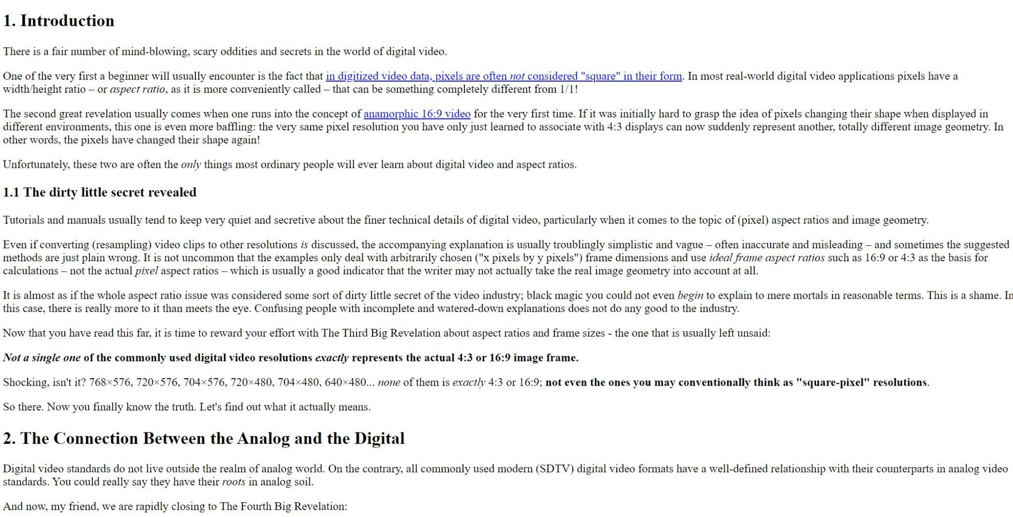

Notes:
And now, Ben Turkus with a Dramatic Reading: This is from the website that Alex Habgood linked to, and yes it’s all written like this
Tutorials and manuals usually tend to keep very quiet and secretive about the finer technical details of digital video, particularly when it comes to the topic of (pixel) aspect ratios and image geometry.
Even if converting (resampling) video clips to other resolutions is discussed, the accompanying explanation is usually troublingly simplistic and vague – often inaccurate and misleading – and sometimes the suggested methods are just plain wrong. It is not uncommon that the examples only deal with arbitrarily chosen ("x pixels by y pixels") frame dimensions and use ideal frame aspect ratios such as 16:9 or 4:3 as the basis for calculations – not the actual pixel aspect ratios – which is usually a good indicator that the writer may not actually take the real image geometry into account at all.
It is almost as if the whole aspect ratio issue was considered some sort of dirty little secret of the video industry; black magic you could not even begin to explain to mere mortals in reasonable terms. This is a shame. In this case, there is really more to it than meets the eye. Confusing people with incomplete and watered-down explanations does not do any good to the industry.
Now that you have read this far, it is time to reward your effort with The Third Big Revelation about aspect ratios and frame sizes - the one that is usually left unsaid:
Not a single one of the commonly used digital video resolutions exactly represents the actual 4:3 or 16:9 image frame.
Shocking, isn't it? 768×576, 720×576, 704×576, 720×480, 704×480, 640×480... none of them is exactly 4:3 or 16:9; not even the ones you may conventionally think as "square-pixel" resolutions.
So there. Now you finally know the truth. Let's find out what it actually means.

Slide 19
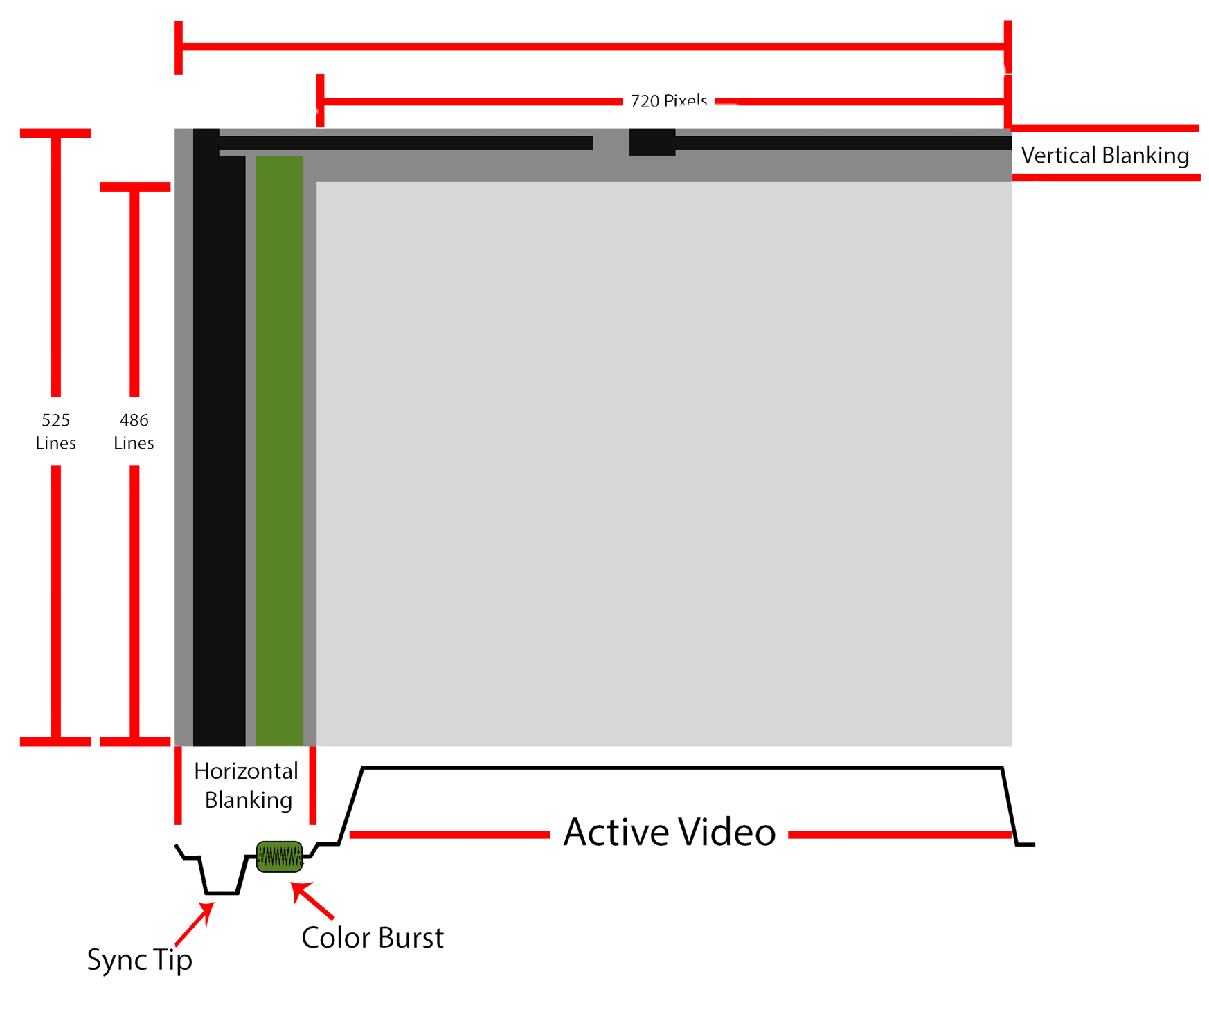
HOW DIGITIZATION WORKS
Notes:
This article goes deep into describing the exact issue I was running up against! However, in order to understand it fully we need to understand how video digitization works in the first place. So, let’s dive in!
A quick note, all these numbers are for NTSC! Sorry PAL heads. It’s basically all the same concepts here, just different numbers. Please forgive my pigheaded american-exceptionalism.
First, we need to understand what a whole video frame looks like. Here’s a picture here, this is all 525 lines of a video frame, including the vertical and horizontal blanking area. You can see the sync tip and color burst on the left-hand side. You can see the vertical sync on the top. Below the frame is what a single line of video looks.

Slide 20
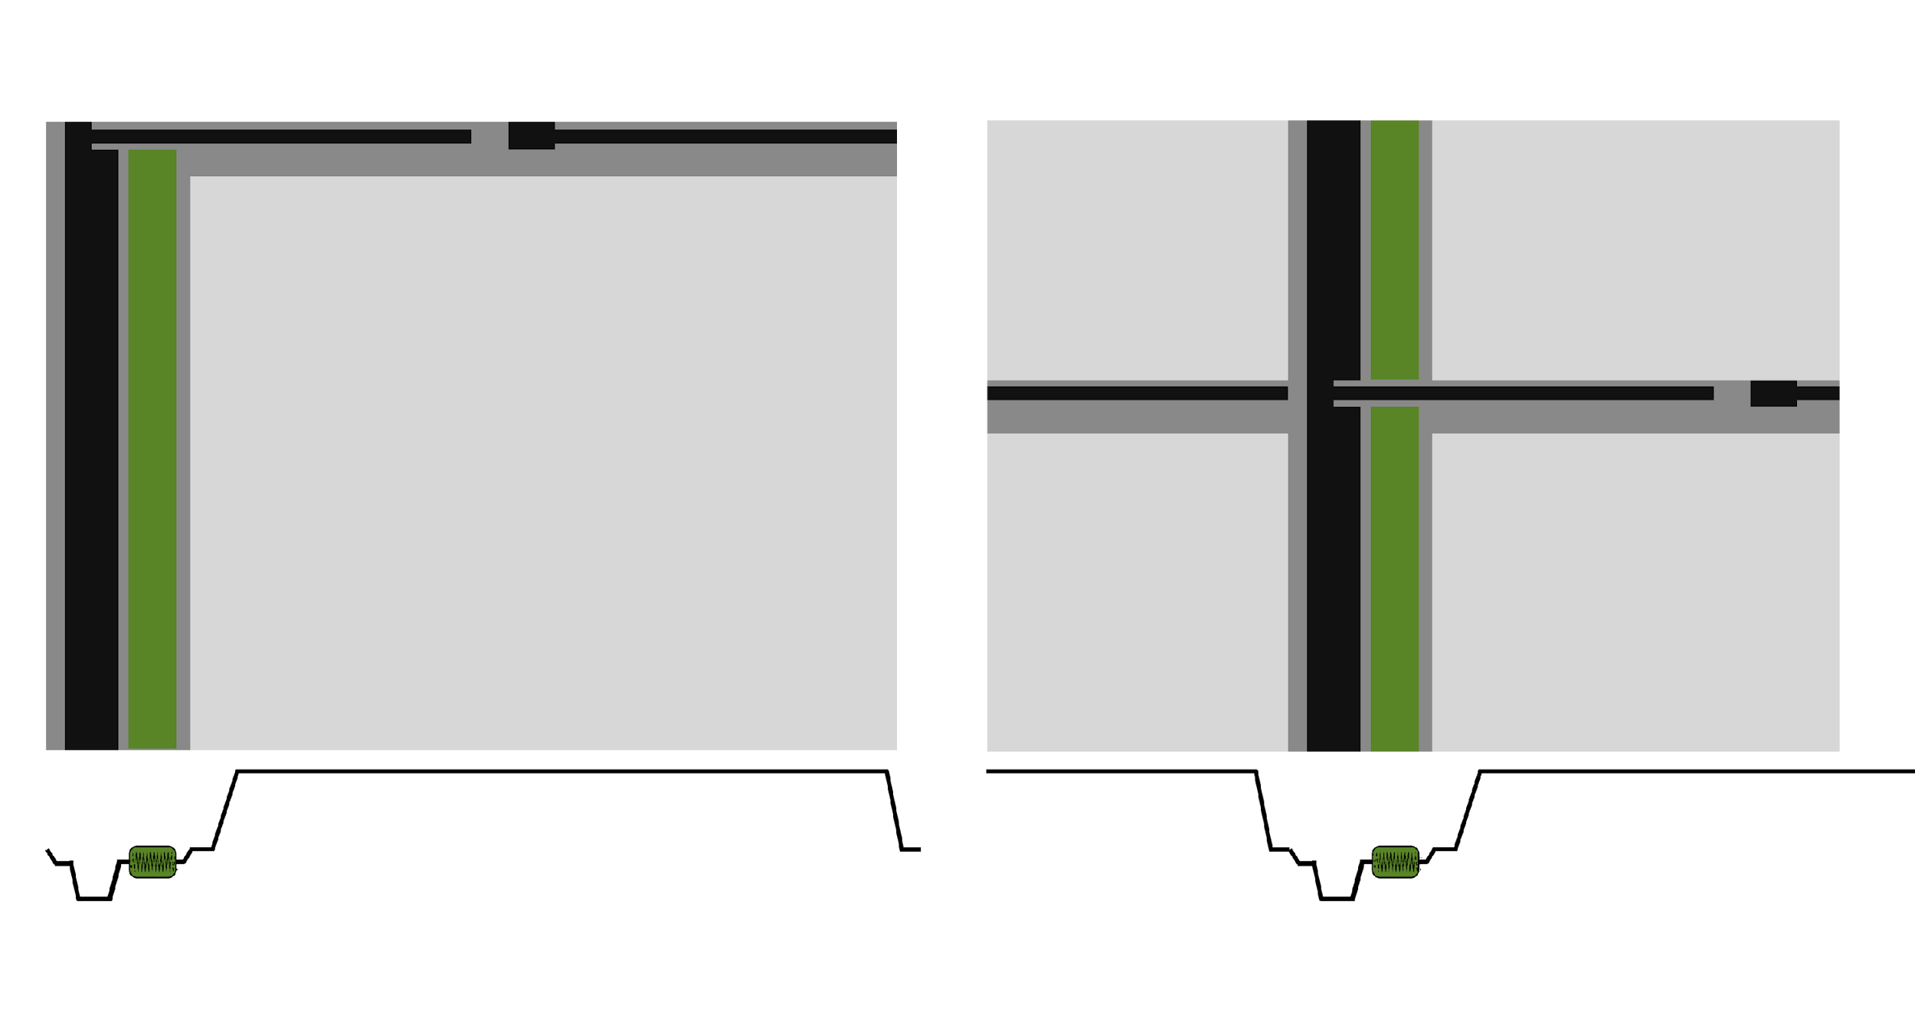
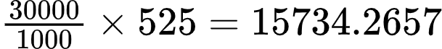
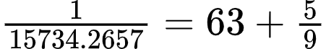
_
63.55 µs
29.97003 fps x 525 lines per frame
HOW DIGITIZATION WORKS
lines per second
microseconds per line
Notes:
Here is the math that we can use to derive how long it takes a single line of video to be drawn. 29.97 frames per second, and 525 lines per frames, gives the answer. It takes 63 and 5/9 microseconds to draw a single line of video. As a decimal, that’s 63.555555

Slide 21
_
_
52.655 µs
10.9 µs
HOW DIGITIZATION WORKS
Horizontal Blanking Area is 10.9
Active video is only 52.655 μs
(63.555μs - 10.9μs = 52.655μs
Notes:
But, we only actually digitize the active video portion of the line. This is maybe perhaps somewhat controversial. There are digitization systems that will capture the vertical and possibly the horizontal blanking areas. However, it’s not common. While this is certainly a good conversation topic, it’s best left for another panel. In any case, the Horizontal Blanking Area is defined as 10.6 μs (according to SMPTE 170M, so if we subtract that we get that the active video is 52.655
Why? I guess it looks better. Not my decision. Either way, that active video portion of the line is 52.65555 microseconds long. You’ll just have to trust me on that one.

Slide 22
_
52.655 µs
13.5 MHz
HOW DIGITIZATION WORKS
13.5 MHz decided by ITU-R BT.601
Notes:
When we digitize a video we’re basically capturing a tiny slice of this line of video as it’s being drawn. Obviously this has to happen very very quickly in order for there to be enough quality to properly render the video. The International Telecommunication Union Radiocommunication Sector ITU-R standardized the sampling rate for digitizing video in the BT.601 recommendation as 13.5 MHz. This means that 13.5 million samples are captured every second.

Slide 23
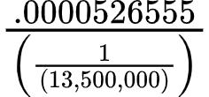
_
52.655 µs
13.5 MHz
HOW DIGITIZATION WORKS
_
or 52.655 x 13.5 = 710.85
Notes:
The math to figure out how many samples per line is basically taking the duration of the line and dividing it by one over the sampling rate. Or, simplified, 52.655 times 13.5. Which equals 710.85! this means that 710.85 pixels are created from each line. But wait, that number doesn’t even make sense! What about 720?

Slide 24
_
52.65 µs
_
_
.3388 µs
.3388 µs
HOW DIGITIZATION WORKS
_
_
_
52.65 + .3388 + .3388 = 53.33
53.33 x 13.5 = 720
_
Notes:
Well, this is where 720 comes from. If you add a little bit of the blanking area on each side, about a third of a microsecond, then you end up with 53.3333 microseconds as your total sampled line duration. and 53.33333 times 13.5, is equal to 720.
The point of these extra thirds of a microsecond are to account for timing variations endemic to analog video. This way, if your video is a little early or delayed, you won’t lose the content during digitization.

Slide 25

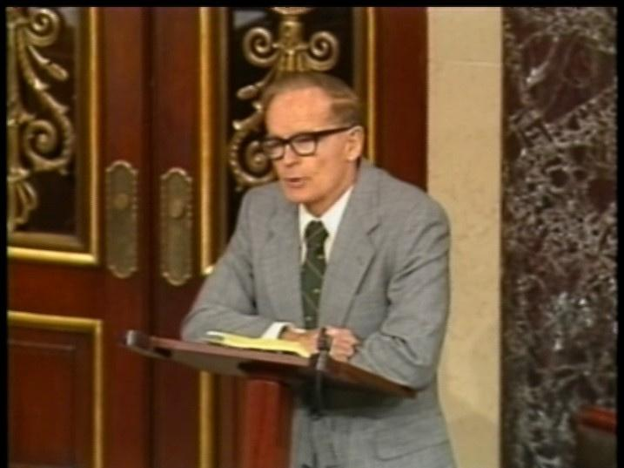
Notes:
You see those little black lines on the left and right side of the frame? Those are the extra thirds of a microsecond that give a bit of tolerance to timing issues. If we only captured 710.85, or 711 pixels then we’d risk losing some content if the active video was scooted over a little to the left or right.
I hope this makes sense, because we’re about to jump back into Aspect Ratio!

Slide 26

Notes:
Since those black bars on the side are not part of the active video, we shouldn’t use them when calculating the Display Aspect Ratio! If the Display Aspect Ratio is set to 4:3 using these, then the geometry of the active video will be distorted.

Slide 27

Notes:
Instead, the display aspect ratio should be based only on those 710.85 pixels in the middle of picture that contain active video!

Slide 28
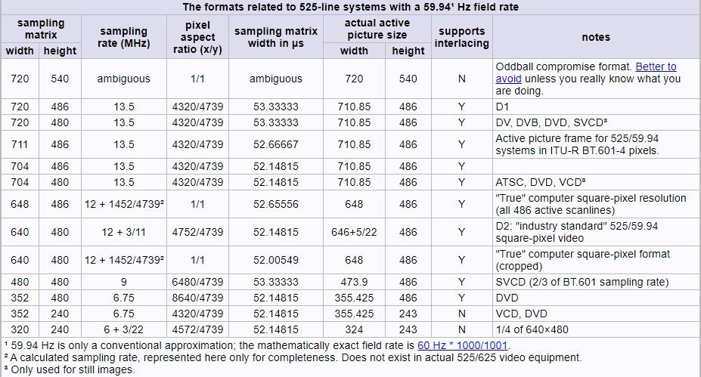
Notes:
And now, with all this info we can we can finally dive into this very scary matrix on the website we were discussing. Yes I’m well aware how intense this looks.

Slide 29
D1 standardized as part of ITU-R BT.601
Notes:
In reality though, you only need to worry about this line here.
It says that if we create a 720x486 frame at 13.5 MHz, then a Pixel Aspect Ratio of 4320/4739 must be used to create the proper display aspect ratio for a file where the actual active picture is is 710.85 by 486. And that this is the PROPER display aspect ratio for D1 video, which is the standardized digital video format discussed in BT.601!
****It’s the standard that is referenced by any system properly creating digital video from an analog source!*** (is this true?)

Slide 30
Prove it With Math
SAR x PAR = DAR
710.85
x
4320
=
4
486
4739
3
720
4320
x
=
1.35049589
486
4739
Notes:
Again, I fully understand at how sounds unhinged this may seem. How could 4320/4739 be correct? Well, let’s take a look at the math and our trusty SAR x PAR = DAR formula.
If we look at video that’s 710.85 by 486 and use that crazy prescribed pixel aspect ratio, we get exactly 4:3! This means while the entire frame 720x486 frame has a display aspect ratio that’s slighter greater than 4:3, the active video in between the black lines is exactly 4:3!

Slide 31

PAR = 1/1
OpenCube
NTSC Video
PAR = 4320/4739
True D1
new vrecord
Black Magic
Premiere
PAR = 10/11
PAR = 9/10
old vrecord
old SAMMA Solo
PAR = 8/9
DV, DVCAM, DVCPRO, DVD
Notes:
However it’s hard to simply take for granted the rantings of a mad man. Could this unhinged fraction be the TRUE NTSC pixel aspect ratio?
Well let's take a look at some other options. We’ve got a par of 1. Square pixels. Which I’ve seen on some platforms like the EVS OpenCube. This ends up making very wide videos with about a 3:2 display aspect ratio.
We’ve got the crazy 4320/4739, then slightly thinner 10/11, currently used by vrecord, blackmagic, and premiere, thinner yet 9/10 used by early generation SAMMA, and thinnest 8/9.

Slide 32
More Math
PAR of 9/10 makes the entire 720 frame have a DAR of 4/3, but we know this isn’t actually correct!
SAR x PAR = DAR
710.85
x
9
=
1.31638889
486
10
720
x
9
=
4
486
10
3
This is how the SAMMA did it, which we now know is wrong
Notes:
A pixel aspect ratio of 9/10, which was used by the earlier SAMMA and older versions of vrecord would make a 720x486 file have a perfect 4:3 display aspect ratio. But we now know this is wrong! We aren’t trying to make all 720 pixels in the width of the video 4:3. only the 710.85 pixels in the center of the line!

Slide 33
More Math
SAR x PAR = DAR
710.85
x
10
=
1.32968575
486
11
720
x
10
=
1.34680135
PAR of 10/11 makes the 710.85 frame with video have a DAR of very nearly 4/3
(off by 0.003)
486
11
Notes:
The 10/11 pixel aspect ratio on the hand gets quite close to a 4:3 aspect ratio for the active video portion. it’s off by 0.003. So, it’s about as close as simple fraction can get!

Slide 34
More Math
SAR x PAR = DAR
710.85
x
8
=
1.30013717
486
9
720
x
8
=
4
8/9 is for DV, which has no blanking on the side and 6 fewer horizontal lines. Thus the full 720x480 frame is 4:3
480
9
3
Notes:
And a quick note on 8/9. While it’s totally off for 710.85 over 486, it’s dead on for 720x480. Which is the frame size of digital video formats like DV, DVCAM, DVCPro, and DVD. Also, these don’t have blanking lines on the sides of the frame, the whole frame is 720x486! So, 8/9 is a useful number, but not for analog video!

Slide 35
PAR = 1/1
Makes very wide files
PAR = 4320/4739
True D1
Technical correct but nobody uses it
new vrecord
Black Magic
Premiere
PAR = 10/11
Most commonly used in commercial software
PAR = 9/10
old vrecord
old SAMMA Solo
This shouldn’t be used!
PAR = 8/9
DV, DVCAM, DVCPRO, DVD
Used only for 720x480 digital video
Notes:
So we can do a quick roundup now.

Slide 36
Forming a Community Consensus
Storage Aspect Ratio and Display Aspect Ratio are just metadata fields
Changing these fields doesn’t affect the preservation of the content
How do we form a community consensus about these fields?
Notes:
In truth, Storage Aspect Ratio and Display Aspect Ratio are just metadata fields that affect the display of the content. Changing these doesn’t affect the “preservedness” of the content. Having created files with 1/1, 8/9 or 9/10 pixel aspect ratios doesn’t make them wrong or bad. It’s possible to use a tool to change these metadata fields, but also it may not be necessary, especially if you have access files that have settings to correctly render the aspect ratio!
HOWEVER: As archivists we should come to a community consensus about these metadata fields, rather than rely on vendors to make the decision for us. And now that everyone in this room as basically an expert on the topic, we can start that discussion!

Slide 37
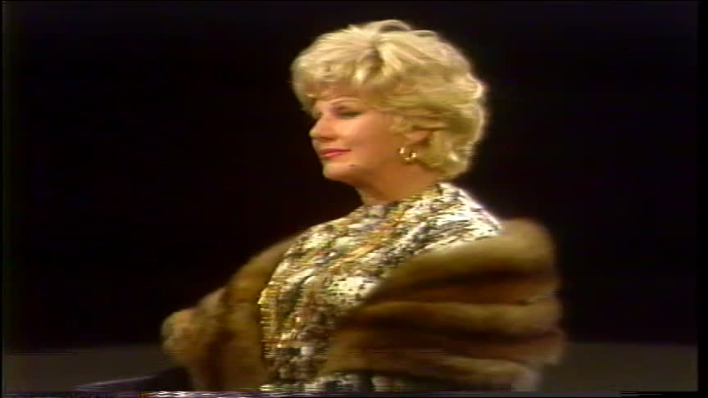

Notes:
My name is Dave Rice. I'm an archivist at City University of New York and I hope you're ready to hear even more about aspect ratio. As an audiovisual archivist, on the subject of aspect ratio, I've often encountered an abundance of confusion and frustration, inconsistent terminology, workarounds for undiagnosed issues, and the impact of a lack of community consensus on this one particular technical value. Before delving into my presentation, I wanted to offer an inspirational quote from a member of community. I wanted something thoughtful that would provoke us to reflect and consider something that is a simple ratio of numbers, but truly one of the significant properties of audiovisual media. Fortunately in lieu of a such a quote, we have the potential to hear the live, passionate words of Skip Elsheimer to set the vibe for this presentation. Please welcome Skip to the stage to offer a spontaneous minute long rant on the topic of aspect ratio.

Slide 38

"..." -- Skip Elsheimer, 2024-12-05

Slide 39
Pixel Aspect Ratio
Crop Aspect Ratio
Video Aspect Ratio
Image Aspect Ratio
Frame Aspect Ratio
Native Aspect Ratio
Picture Aspect Ratio
Display Aspect Ratio
Sample Aspect Ratio
Storage Aspect Ratio
Viewing Aspect Ratio
Encoded Aspect Ratio
Projection Aspect Ratio
Notes:
Of course there is a disastrously confusing list of phrases associated with this topic. But generally there are 2 essential concepts involved.

Slide 40
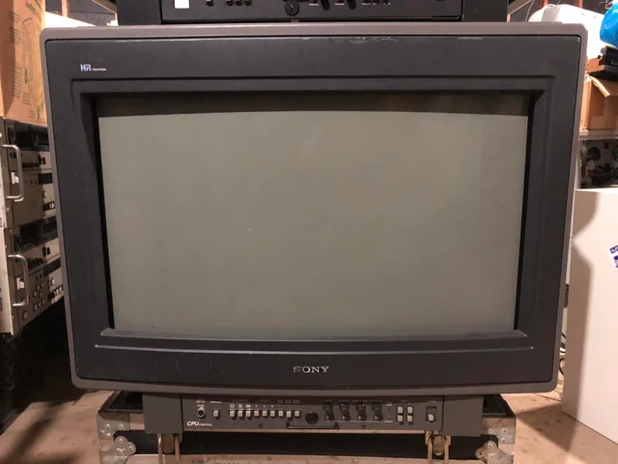
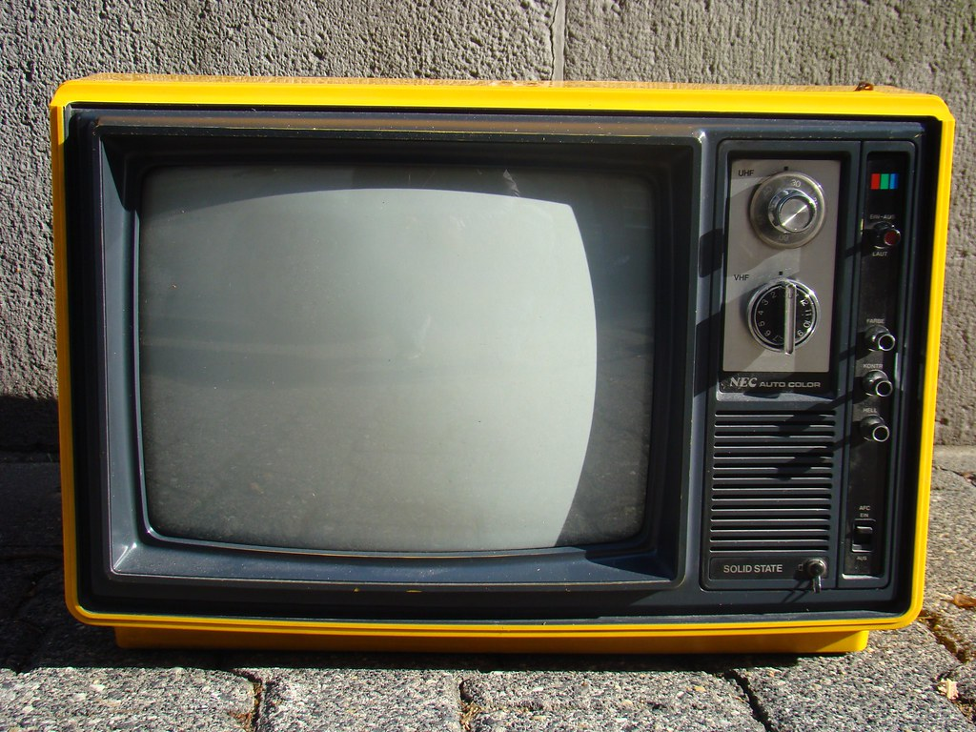
Pixel Aspect Ratio
Crop Aspect Ratio
Video Aspect Ratio
Image Aspect Ratio
Frame Aspect Ratio
Native Aspect Ratio
Picture Aspect Ratio
Display Aspect Ratio
Sample Aspect Ratio
Storage Aspect Ratio
Viewing Aspect Ratio
Encoded Aspect Ratio
Projection Aspect Ratio
Notes:
An essential term here is display aspect ratio which references the ratio of the width and height of a display. For example here's two analog CRT's one with a 16/9 display aspect ratio and one with a 4/3 display aspect ratio. The term display aspect ratio has meaning in the context of both analog and digital video.

Slide 41
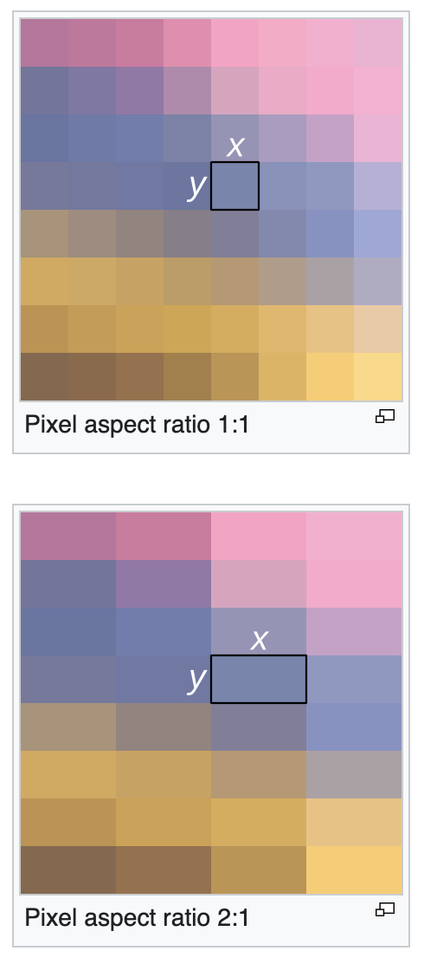
Pixel Aspect Ratio
Crop Aspect Ratio
Video Aspect Ratio
Image Aspect Ratio
Frame Aspect Ratio
Native Aspect Ratio
Picture Aspect Ratio
Display Aspect Ratio
Sample Aspect Ratio
Storage Aspect Ratio
Viewing Aspect Ratio
Encoded Aspect Ratio
Projection Aspect Ratio
Notes:
The other essential term here is sometimes called Pixel Aspect Ratio and sometimes called Sample Aspect Ratio. Preference for the which term tends to derive from particular originating communities with broadcast and production communities often preferring Pixel Aspect Ratio and internet and computer video communities tending to use Sample Aspect Ratio. Whereas Display Aspect Ratio is a ratio of the width and height of the displayed video, pixel or sample aspect ratio is the ratio of the width to height of the individual pixel or sample recorded.

Slide 42
Pixel Aspect Ratio -> PAR
Crop Aspect Ratio
Video Aspect Ratio
Image Aspect Ratio
Frame Aspect Ratio
Native Aspect Ratio
Picture Aspect Ratio -> PAR
Display Aspect Ratio
Sample Aspect Ratio
Storage Aspect Ratio
Viewing Aspect Ratio
Encoded Aspect Ratio
Projection Aspect Ratio
Notes:
As different communities that favor differing terminology come to interact with each other, the use of abbreviations can make everything so much more confusing. Particularly as an abbreviate can reference terms that mean completely different things such as with PAR.

Slide 43
Pixel Aspect Ratio
Crop Aspect Ratio
Video Aspect Ratio
Image Aspect Ratio
Frame Aspect Ratio
Native Aspect Ratio
Picture Aspect Ratio
Display Aspect Ratio
Sample Aspect Ratio -> SAR
Storage Aspect Ratio -> SAR
Viewing Aspect Ratio
Encoded Aspect Ratio
Projection Aspect Ratio
Notes:
and SAR

Slide 44
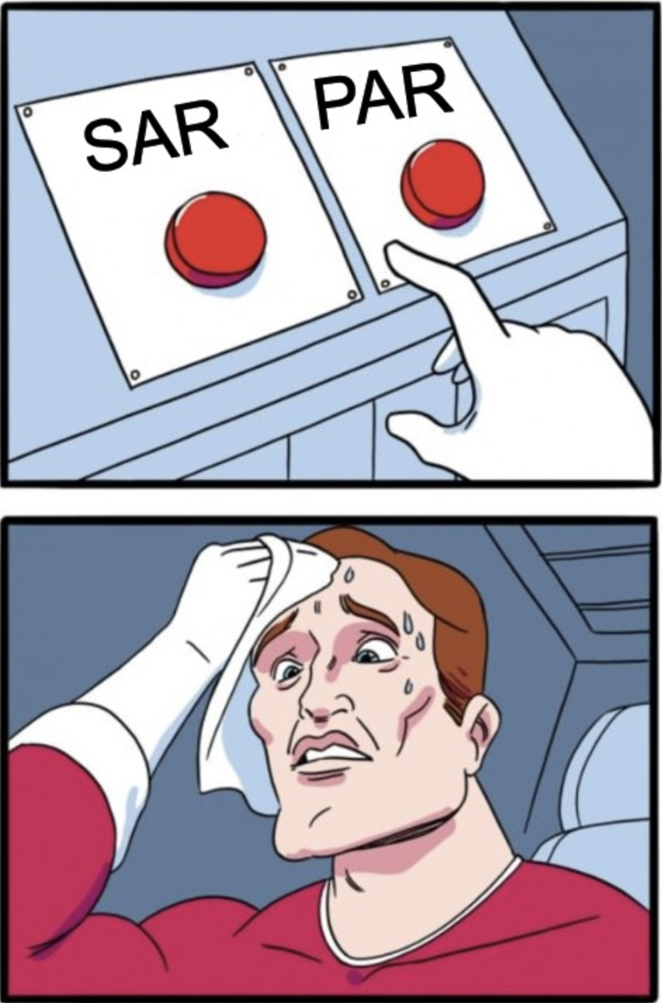
Picture Aspect Ratio
aka
Storage Aspect Ratio
Pixel Aspect Ratio
aka
Sample Aspect Ratio
Notes:
Because of this, I'd recommend using the unabbreviated term when communicating about this issues or at least clarifying clearly what you're talking about when you use an abbreviation.
This morning I was discussing this issue with James Snyder and he mentioned that when receiving a question about a term related to aspect ratio that he'll start with asking "well what does that term mean to you?"

Slide 45
SAR * PAR = DAR
Notes:
so an equation such as this, needs context

Slide 46
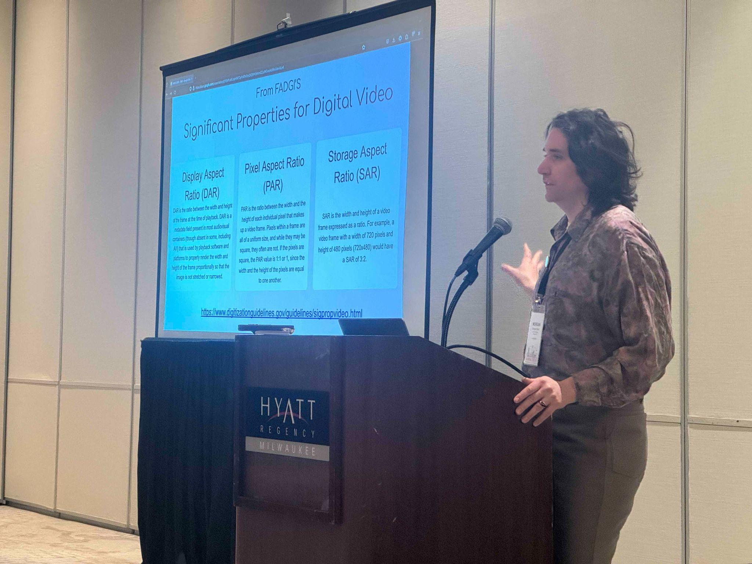
SAR?
*
PAR?
=
DAR?
Notes:
This presentation builds on an earlier presentation from the 2024 AMIA that would opt to priotize terms like Storage Aspect Ratio and Pixel Aspect Ratio.

Slide 47
SAR * PAR = DAR
Storage Aspect Ratio * Pixel Aspect Ratio = Display Aspect Ratio
(W/H) * SAR = DAR
(W/H) / DAR = SAR
( Width / Height) *
Sample Aspect Ratio = Display Aspect Ratio
( Width / Height) /
Display Aspect Ratio = Sample Aspect Ratio
Notes:
So here I've expected that with the full terms.
Then on the right I list the same as Morgan's equation but with the terminology that I'm accustomed to.

Slide 48
Pixel Aspect Ratio
Crop Aspect Ratio
Video Aspect Ratio
Image Aspect Ratio
Frame Aspect Ratio
Native Aspect Ratio
Picture Aspect Ratio
Display Aspect Ratio
Sample Aspect Ratio
Storage Aspect Ratio
Viewing Aspect Ratio
Encoded Aspect Ratio
Projection Aspect Ratio
Notes:
I'm going to focus on one term here. And that's sample aspect ratio. Some may prefer the nearly analogous term Pixel Aspect Ratio, but I personally prefer Sample Aspect Ratio. This term is commonly used in standards from the IEC, IETF, h264, and is used by the ffmpeg community.
In the construction of an audiovisual file I believe this term is actually the more important to understand. Before getting into the aspect ratio part, I'm going to review, in video terms, what is a sample.

Slide 49


Samples :D
Notes:
ffmpeg -i wisconsin.jpg -vf "scale=1080:720,geq=lum=if(eq(mod(Y\,30)\,0)\,lum(X\,Y)\,0):cb=if(eq(mod(Y\,30)\,0)\,cb(X\,Y)\,0):cr=if(eq(mod(Y\,30)\,128)\,cr(X\,Y)\,128)" wisconsin-s30.jpg
I'll use this image of a Wisconsin landscape to provide an example of sampling. In this landscape image, lightwaves from the sun, which is off camera, are bouncing into natural objects that either absorb or reflect ranges of lightwaves. Some of these lightwaves enter the lens of a camera that records the data carried by the light waves, such as brightness and color. The amount of information here is approximately infinite which is too big to store on a camera card, so to store this information on a finite medium, we have to take a samples of that information.
In an analog video camera, it will sample from that information in a raster scanning process. Here a scanner will read horizontally, line by line, across the image and convert image variations into electrical signals to store of videotape.

Slide 50

30 scan lines sampled
Notes:
ffmpeg -i wisconsin.jpg -vf "scale=640:480,geq=lum=if(eq(mod(Y\,16)\,0)\,lum(X\,Y)\,0):cb=if(eq(mod(Y\,16)\,0)\,cb(X\,Y)\,0):cr=if(eq(mod(Y\,16)\,128)\,cr(X\,Y)\,128)" wisconsin-s30a.jpg
This image shows what information would be sampled from that image if we used only 30 scan lines. The information between each sampled scan line is simply not recorded and not included in the selected samples.

Slide 51

30 scan lines sampled
Notes:
ffmpeg -i wisconsin.jpg -vf "scale=640:480,geq=lum=if(eq(mod(Y\,16)\,0)\,lum(X\,Y)\,0):cb=if(eq(mod(Y\,16)\,0)\,cb(X\,Y)\,0):cr=if(eq(mod(Y\,16)\,128)\,cr(X\,Y)\,128)" wisconsin-s30a.jpg
If we reconstruct the image from that sampled data of 30 scans, we can see that only taking 30 scan lines makes for a pretty poor image.

Slide 52

480 scan lines sampled
Notes:
ffmpeg -i wisconsin.jpg -vf "scale=640:480,geq=lum=if(eq(mod(Y\,16)\,0)\,lum(X\,Y)\,0):cb=if(eq(mod(Y\,16)\,0)\,cb(X\,Y)\,0):cr=if(eq(mod(Y\,16)\,128)\,cr(X\,Y)\,128)" wisconsin-s30a.jpg
So for analog videotape we generally use about 480 scan lines to make an acceptable image.

Slide 53
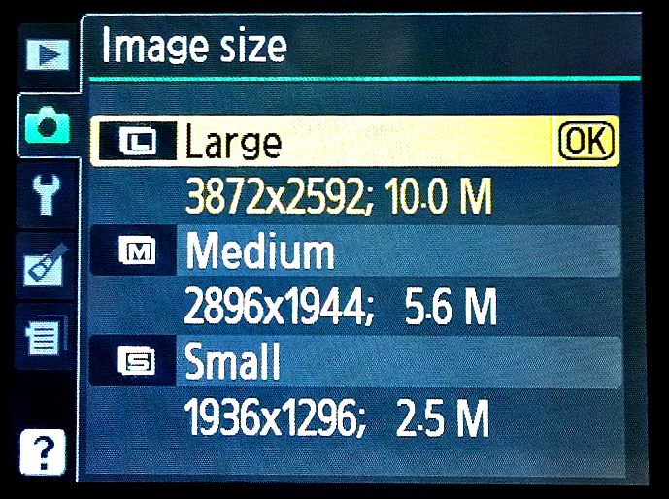
Samples :D
Notes:
In a digital camera these light waves land on a sensor that will sample from that analog information to prepare it for digital storage. Generally our cameras gives us some control over how many samples are recorded. Whereas with the scan lines of analog systems will sample the image data vertically, such as into 480 scan lines, with digital sensors we select both the vertical and horizontal rates of sampling. Here this camera menu is offering some presets as to how many samples to take of the image both horizontally and vertically. The more samples, the more data, and thus higher file size and the more recorded detail.

Slide 54

30 samples
40x30 samples
40 samples
Notes:
ffmpeg -i wisconsin.jpg -vf "scale=640:480,geq=lum=if(eq(mod(Y\,16)\,0)*eq(mod(X\,12)\,0)\,lum(X\,Y)\,0):cb=if(eq(mod(Y\,16)\,0)*eq(mod(X\,12)\,0)\,cb(X\,Y)\,0):cr=if(eq(mod(Y\,16)*eq(mod(X\,12)\,0)\,128)\,cr(X\,Y)\,128)" wisconsin-s30-s40a.jpg
This image shows what data of the original image would be sampled if we opted for 40x30 sampling. This makes for a very low resolution image but you can see an example of how 1,200 samples here are selected from points of the image for recording.
In analog video sampling, the data between the scan lines is disregarded, here all the information outside of the coordinate of the 40x30 samples is lost or disregarded.
Here light travels 93 million miles across the solar system from the sun into this autumn landscape scene in Door County, Wisconsin. Those light waves conditionally bounce off everything in sight, carrying infinite colors and detail, the light is bent by lens to converge onto a sensor that here takes 1,200 digital samples of something that is analog and infinite.

Slide 55

30 samples
40x30 samples
Scaled to 1080x720
Sample aspect ratio of 1/1
40 samples
Notes:
Again sampling at such a low rate, such as 40 by 30, makes a very low resolution image so generally a much higher rate of sampling is used. In digital sensors that rate of veritical and horizontal sampling is generally correlated but doesn't have to be.

Slide 56

30 samples
1080x30 samples
Scaled to 1080x720
Sample aspect ratio of 1/27
1080 samples
Notes:
For instance here I've sampled the image data 1080 times horizontally and only 30 times vertically. There's a high degree of horizontal detail but a low resolution of vertical detail.

Slide 57

720 samples
40x720 samples
Scaled to 1080x720
Sample aspect ratio of 24/1
40 samples
Notes:
This is an opposite extreme of taking 720 samples vertically and 40 samples horizontally.

Slide 58
Sample
Aspect
Ratio?
30 samples
40x30 samples
40 samples
Notes:
So sample aspect ratio is a reference to the distance between the points of sampling, both vertically and horizontally. Here is that image again showing 40x30 sampling and the total of 1200 sample points.

Slide 59

sample aspect ratio numerator
sample aspect ratio denominator
30 samples
40x30 samples
40 samples
Notes:
Here we zoom in so see the spatial relationship between those points better. The exact distance between the sample points isn't relevant here, but what is is the ratio of the vertical distance between sample points to the horizontal distance between sample points. That ratio is the sample aspect ratio.

Slide 60
sample aspect ratio numerator
sample aspect ratio denominator
30 samples
40x30 samples
40 samples
Notes:
As the data collected at each sample can be used to illuminate a pixel, the terms Sample Aspect Ratio and Pixel Aspect Ratio are close to synonymous, though sample aspect ratio references more the collection of data whereas pixel aspect ratio references the storage and presentation of data.

Slide 61
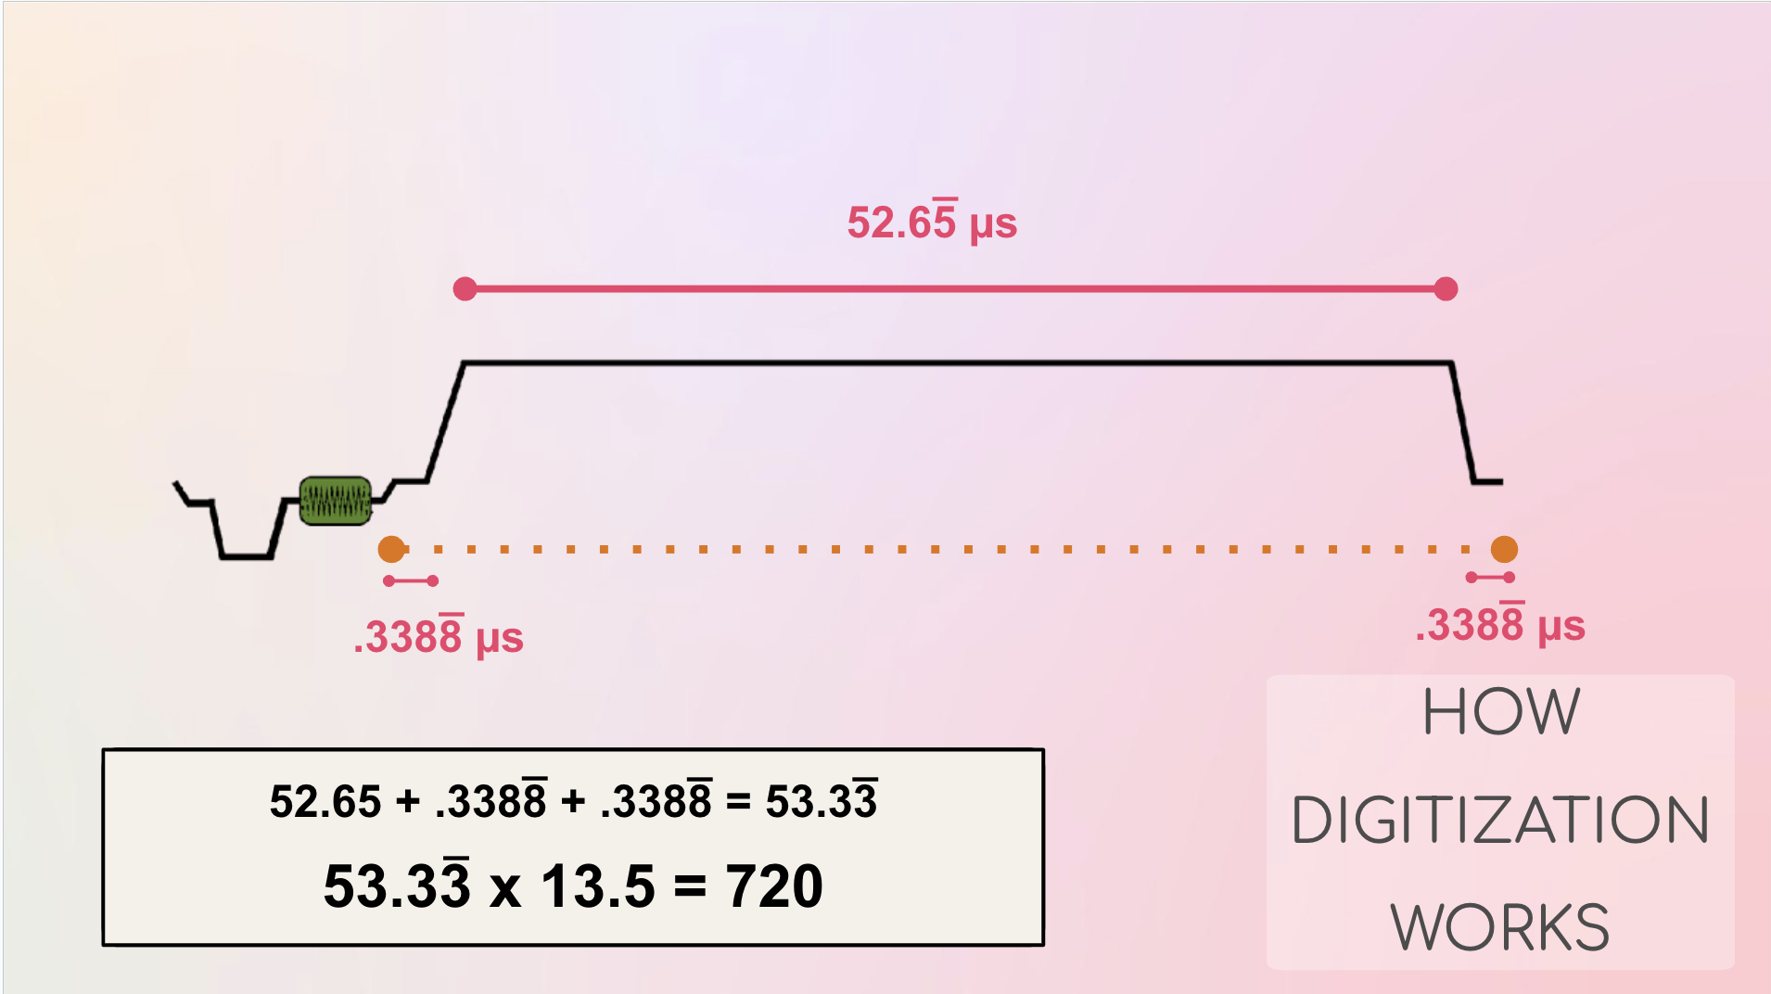
30 scan lines sampled
Notes:
For a digital file from an analog videotape, the horizontal sampling and vertical sampling occur at two different times. The vertical sampling occurs as the scan lines are sampled from the image into an electrical signal to store on tape, which takes place at the time of analog recording. Then during the digitization of that tape, the data is sampled horizontally by taking samples along those electrical signals of each scan line from the tape.
Because of this, the frequency of samples taken horizontally and vertically are decided for completely different reasons, based on different technological limitations. Thus it's quite natural for pixels derived from analog videotape sources to not be square. In early computer video days all samples and pixels were presumed to be square, but as video became a larger and larger part of the internet various audiovisual needed to document the sample aspect ratio to maintain proper presentations.

Slide 62
Aspect Ratio in Formats
Notes:
I'll cover a few examples of how aspect ratio is stored in a few select file formats.

Slide 63
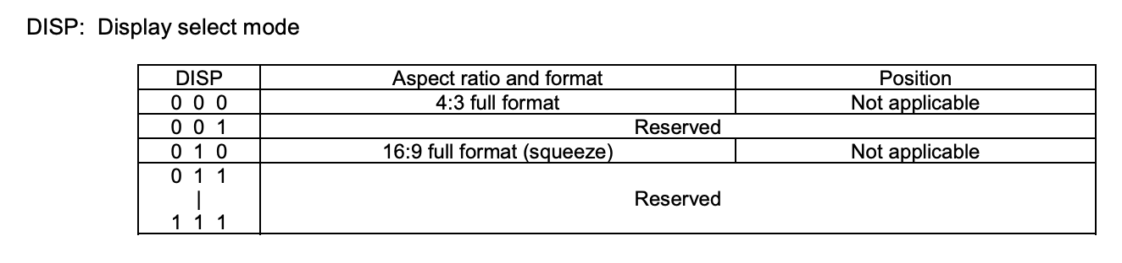
Aspect Ratio in DV 25
Notes:
In DV there's only 2 possible options 4:3 and 16:9 for the display aspect ratio. Correlates to a hardware switch.

Slide 64
Aspect Ratio in DV25
image width | image height | sample aspect ratio width | sample aspect ratio height | display aspect ratio width | display aspect ratio height
( 720 / | 480 ) * | ( 8 / | 9 ) = | ( 4 / | 3 )
( 720 / | 480 ) * | ( 32 / | 27 ) = | ( 16 / | 9 )
( 720 / | 576 ) * | ( 16 / | 15 ) = | ( 4 / | 3 )
( 720 / | 576 ) * | ( 64 / | 45 ) = | ( 16 / | 9 )
Notes:
Since DV 25 uses 720x480 pixel frame size for NTSC and a 720x576 frame size for PAL, we can use the equation to determine the sample aspect ratio for both 4/3 and 16/9 displays.
Formats generally don't store both sample aspsect ratio and display aspect ratio, as with the frame size, one of these values can be used to determine the other.

Slide 65
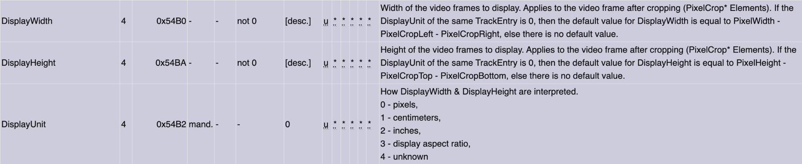
Aspect Ratio in Matroska
Notes:
Matroska stores dar but there are optoins..

Slide 66
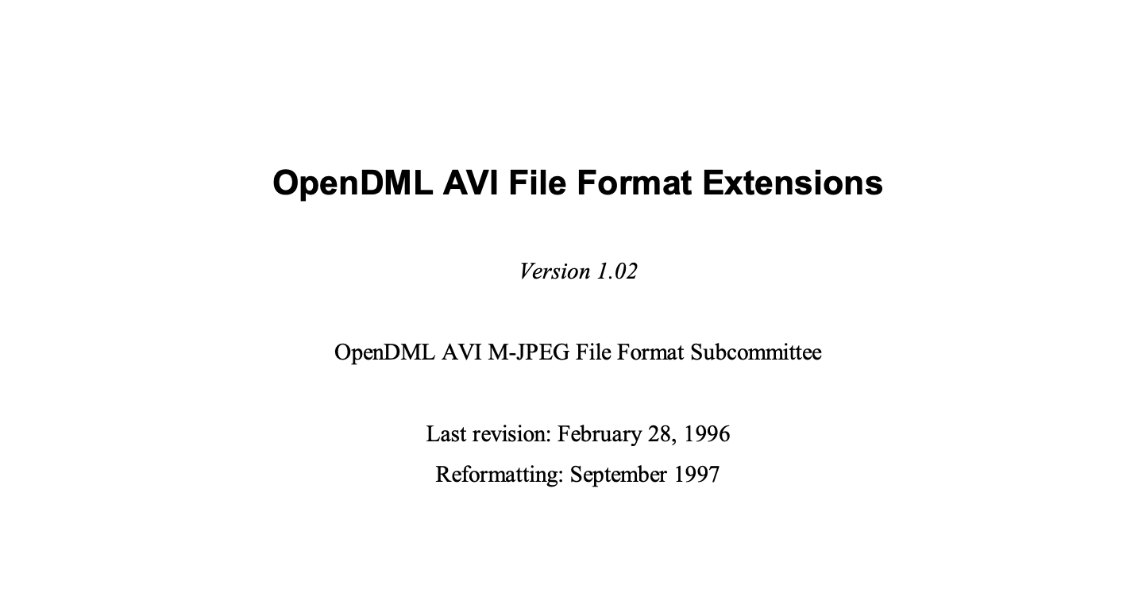
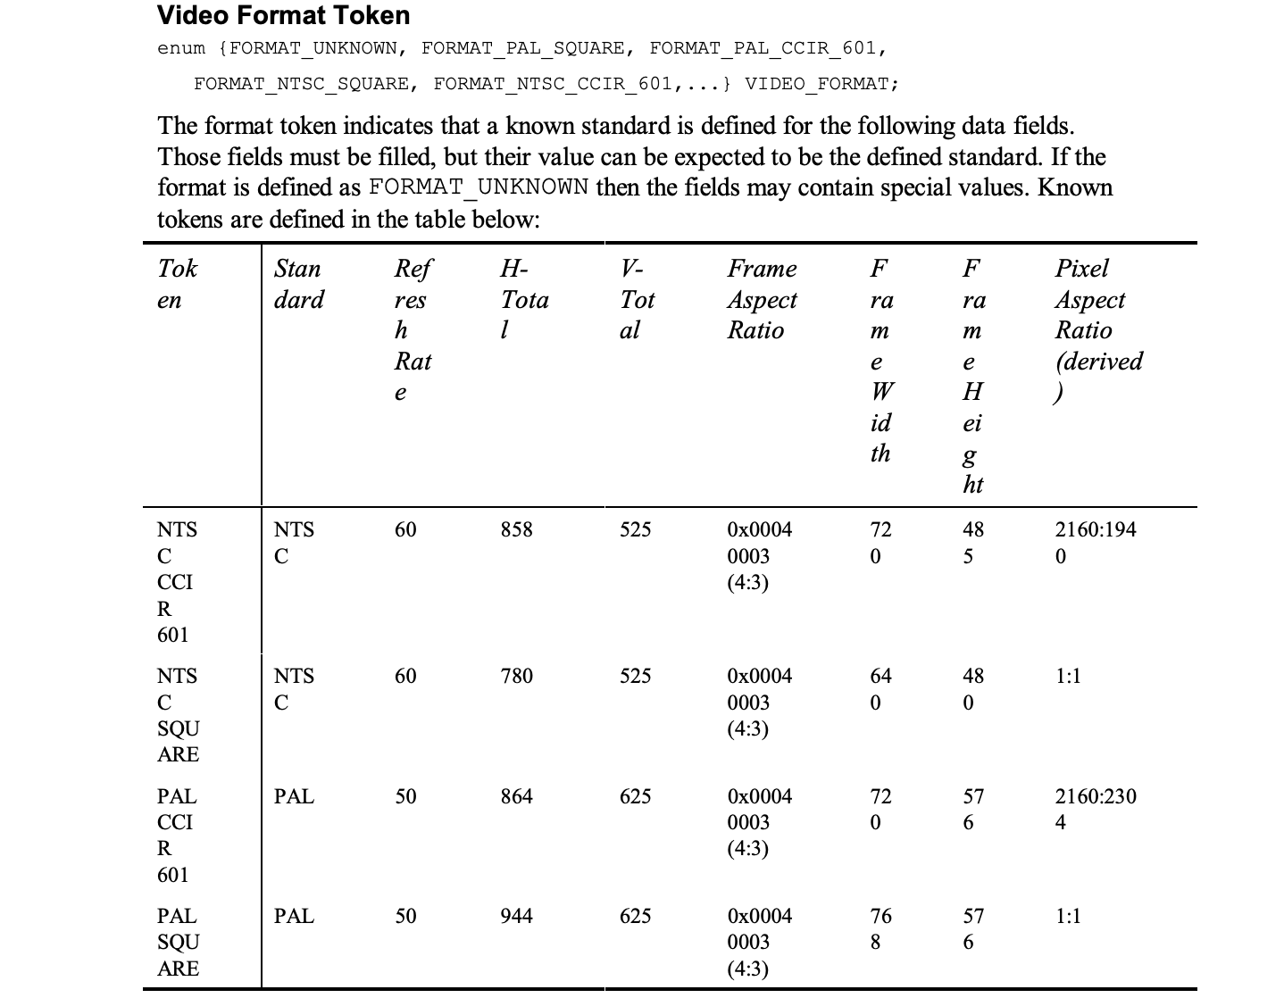
Aspect Ratio in AVI
Notes:
avi also stores DAR, middle column Frame Aspect Ratio
inconsistently applied

Slide 67
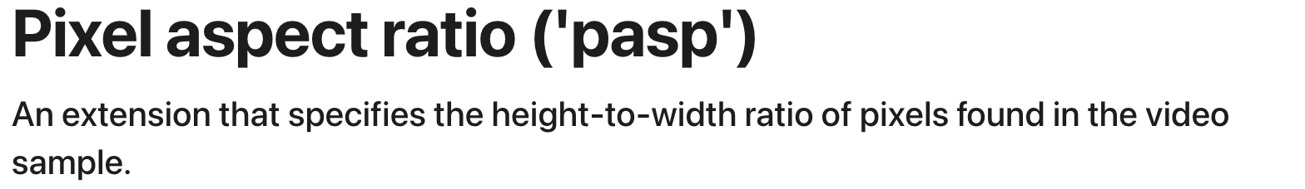
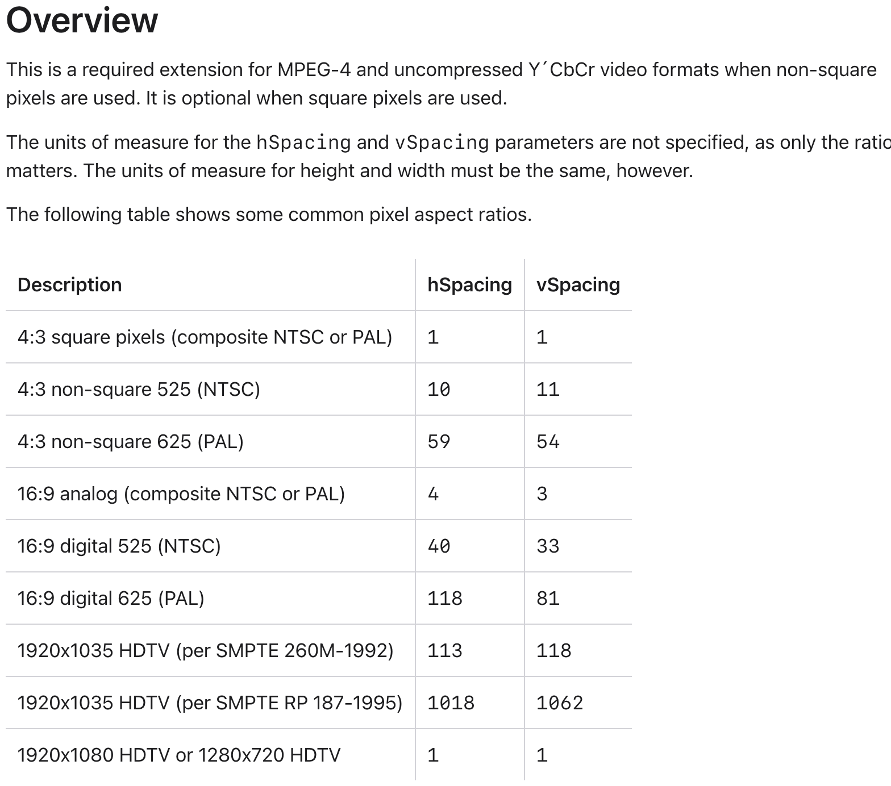
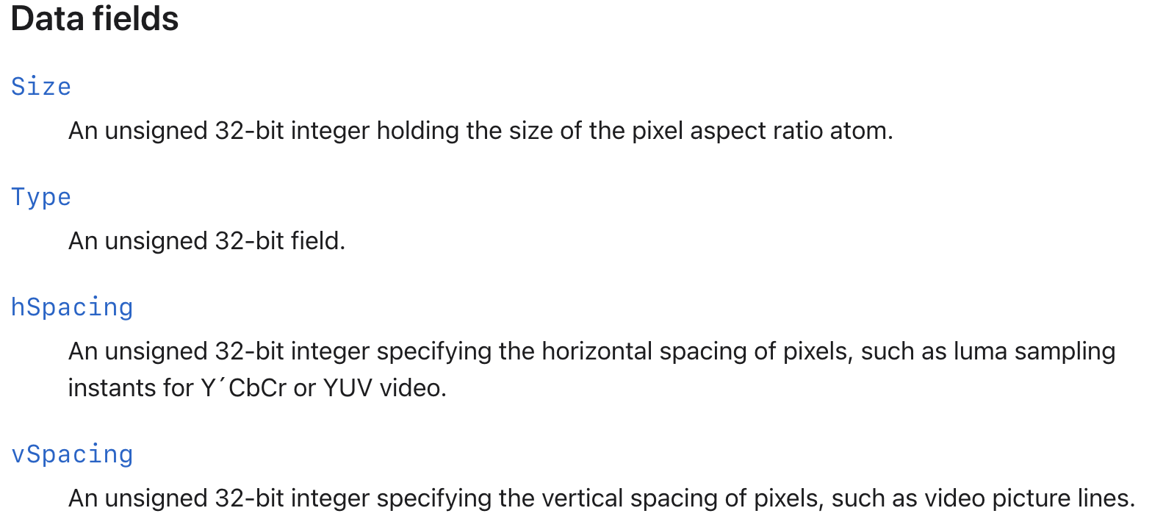
Aspect Ratio in QuickTime
Notes:
QuickTime stores SAR

Slide 68
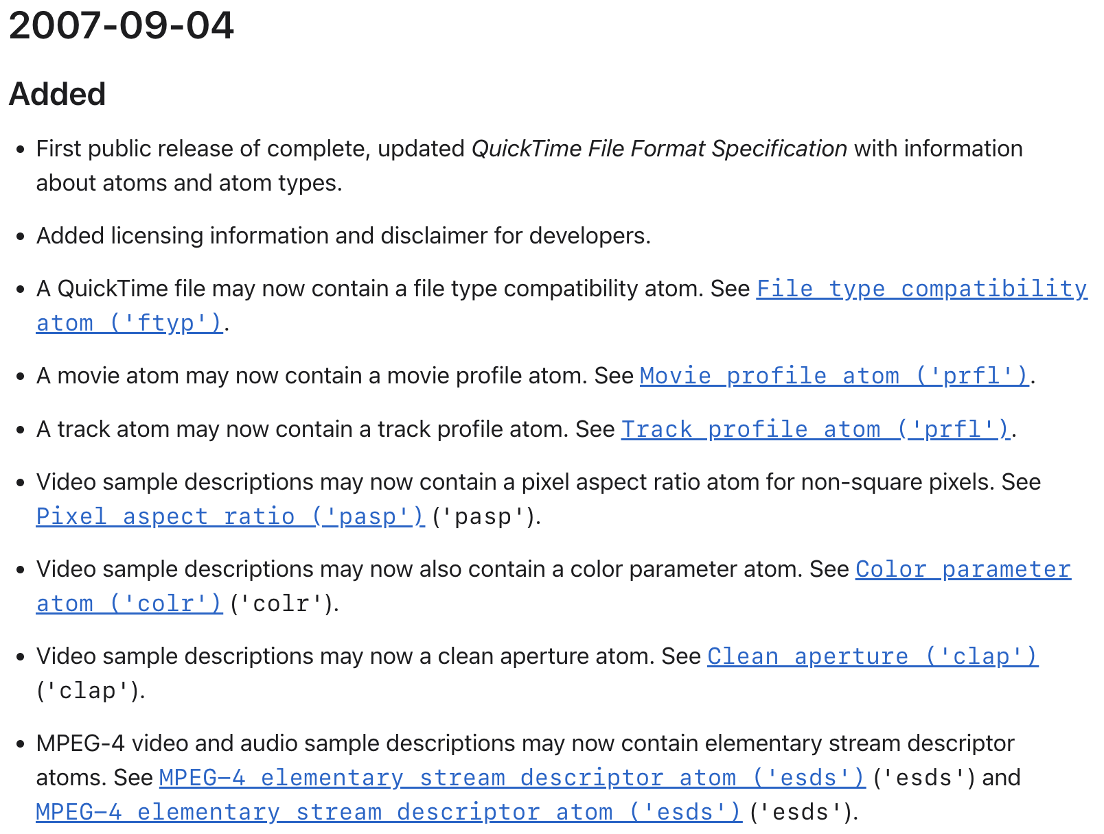
Aspect Ratio in QuickTime
Notes:
QuickTime only started in 2007

Slide 69
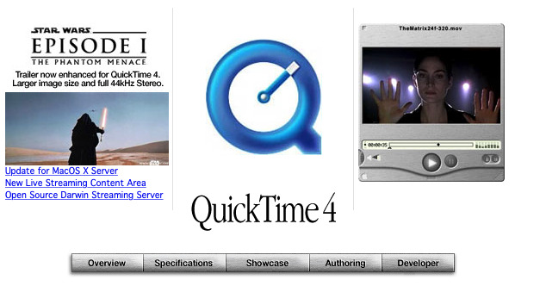
Notes:
QuickTime before. No DAR, no SAR, just pixels presumed to be square

Slide 70
Why does this video has a 3/2 display aspect ratio?
Notes:
frequent forum questions about aspect ratio expectations are based on having video with an undefined aspect ratio

Slide 71
Unspecified aspect ratio
implies square pixels, aka
a sample aspect ratio of 1/1.
Notes:
unspecified behavior of players

Slide 72
Goal: Present video at 4/3 display aspect ratio.
But: Players might inconsistently apply aspect ratio metadata.
So: export access files with a 1/1 sample aspect ratio.
Notes:
workaround
- other option store DAR/SAR

Slide 73


With No Aspect Ratio Metadata
720x480
640x480
Notes:
If the aspect ratio is completely missing, then most (maybe all) players will presume a 1/1 sample aspect ratio and simply show square pixels. Without explicit aspect ratio metadata, a 720x480 frame will appear stretched, since in the original analog recording the distance between horizontal samples is lower than that of the vertical samples.
Thus in many best practices for access media, it used to be suggested to create a 640x480 derivative. By scaling the video down, we lose horizontal resolution but gain the convenience of a frame that will happen to present at a 4/3 display aspect ratio even if no aspect ratio metadata is present. This was a good workaround long ago when aspect ratio was inconsistently written into files or used on displays, but now most major players will use the aspect ratio metadata of most major formats.
Rather than a best practice of using 640x480, I'd suggest a better practice is to ensure that your access files are being written with metadata.

Slide 74
A file with no aspect ratio information
ffmpeg
Stream #0:0[0x1]: Video: v210 (v210 / 0x30313276), yuv422p10le(progressive), 320x240, 43008 kb/s, 25 fps, 25 tbr, 12800 tbn (default)
ffporbe
sample_aspect_ratio=N/A
display_aspect_ratio=N/A
A file with aspect ratio information
ffmpeg
Stream #0:0[0x1]: Video: v210 (v210 / 0x30313276), yuv422p10le(progressive), 320x240, 43008 kb/s, SAR 1:1 DAR 4:3, 25 fps, 25 tbr, 12800 tbn (default)
ffprobe
sample_aspect_ratio=1:1
display_aspect_ratio=4:3
Notes:
dar vs no dar
in old days it used to say 0/1

Slide 75
MediaInfo and Aspect Ratio
$ mediainfo test.avi
General
Complete name : test.avi
Format : AVI
Format/Info : Audio Video Interleave
Format settings : BitmapInfoHeader
File size : 853 KiB
Duration : 40 ms
Overall bit rate : 175 Mb/s
Frame rate : 25.000 FPS
Writing application : Lavf61.7.100
Video
ID : 0
Format : YUV
Codec ID : v210
Codec ID/Hint : AJA Video Systems Xena
Duration : 40 ms
Bit rate : 172 Mb/s
Width : 638 pixels
Height : 480 pixels
Display aspect ratio : 4:3
Frame rate : 25.000 FPS
Color space : YUV
Chroma subsampling : 4:2:2
Bit depth : 10 bits
Scan type : Progressive
Compression mode : Lossless
Bits/(Pixel*Frame) : 22.470
Stream size : 840 KiB (98%)

Slide 76
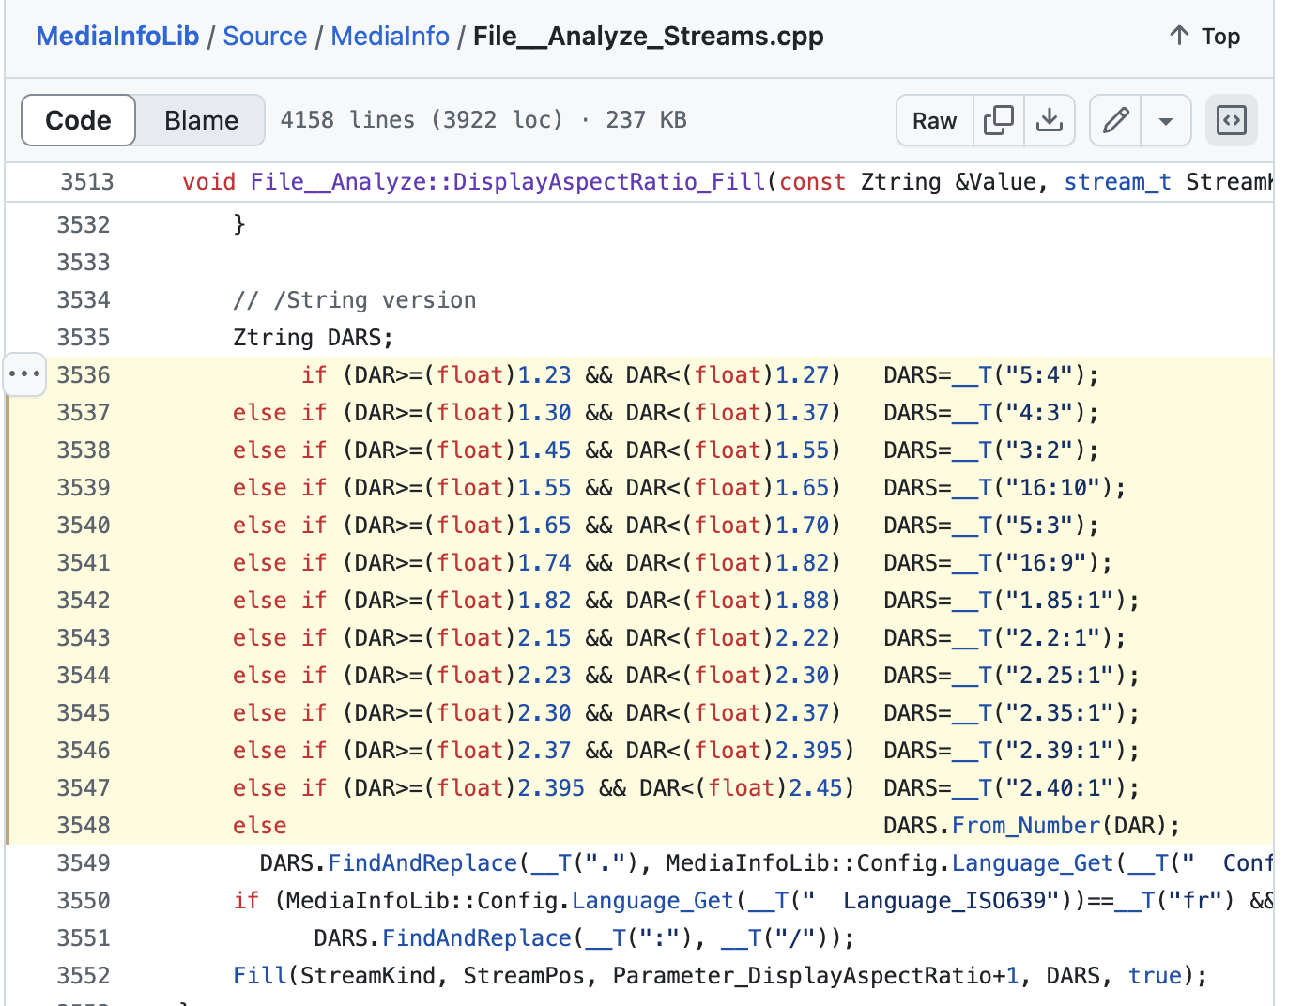
Notes:
ffmpeg will give precise values
but mediainfo rounds

Slide 77
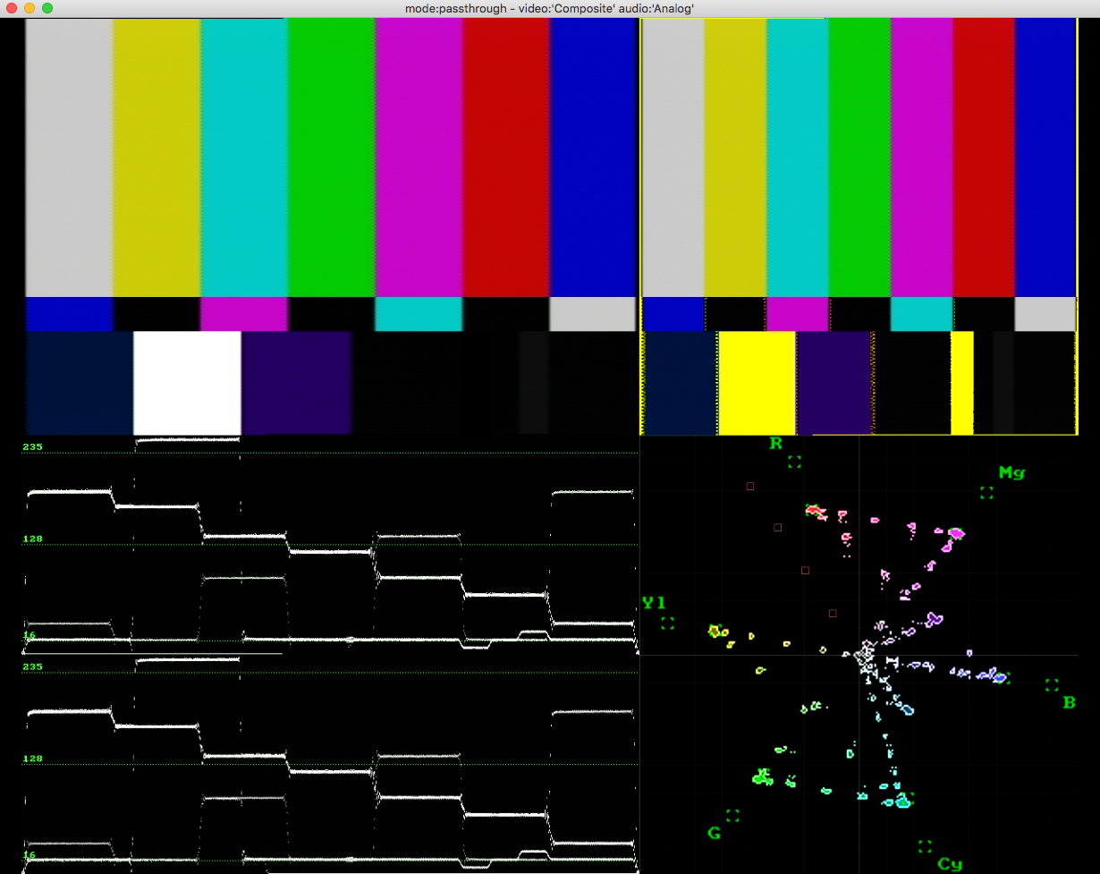
vrecord &
aspect ratio
initially
720x486
display apsect ratio of 4/3
Notes:
so how about vrecord and aspect ratio
at first when setting this up, we set vrecord to capture 720x486 and set the display apsect ratio to 4/3

Slide 78
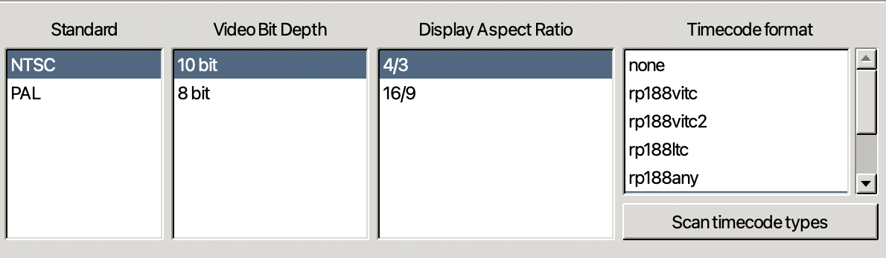

Slide 79
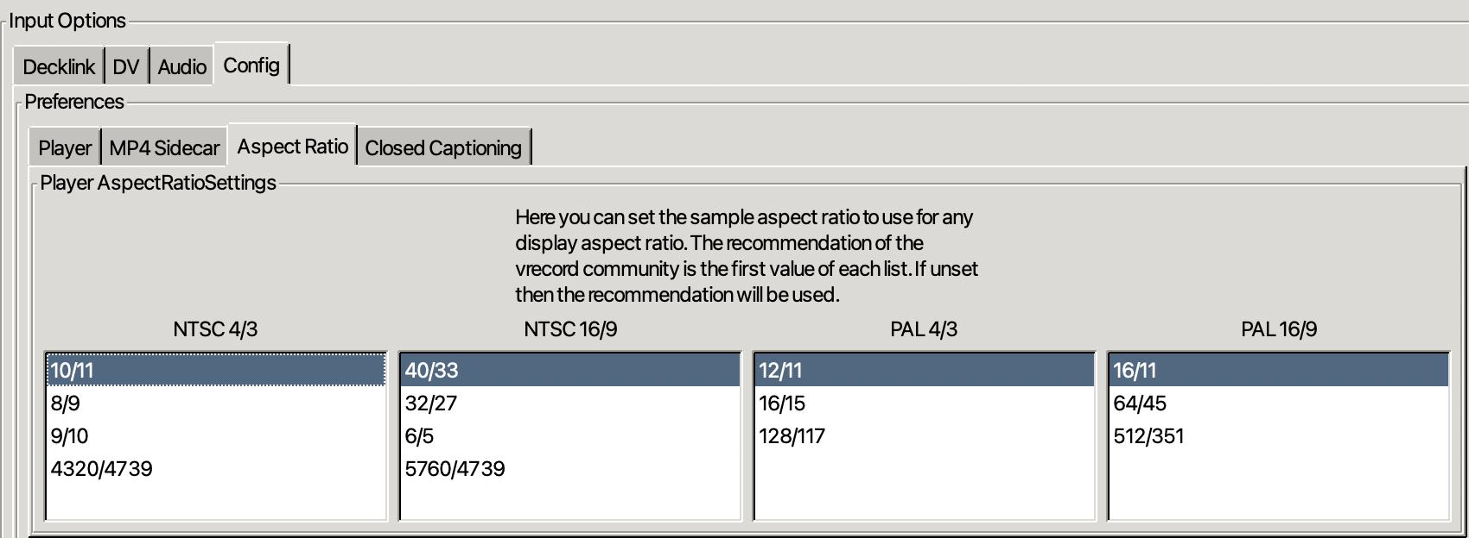

Slide 80
image width | image height | sample aspect ratio width | sample aspect ratio height | display aspect ratio width | display aspect ratio height
( 720 / | 486 ) * | ( 8 / | 9 ) = | ( 4 / | 3 )
( 720 / | 480 ) * | ( 9 / | 10 ) = | ( 4 / | 3 )
( 704 / | 480 ) * | ( 10 / | 11 ) = | ( 4 / | 3 )
( 710.85 / | 486 ) * | ( 4320 / | 4739 ) = | ( 4 / | 3 )

Slide 81
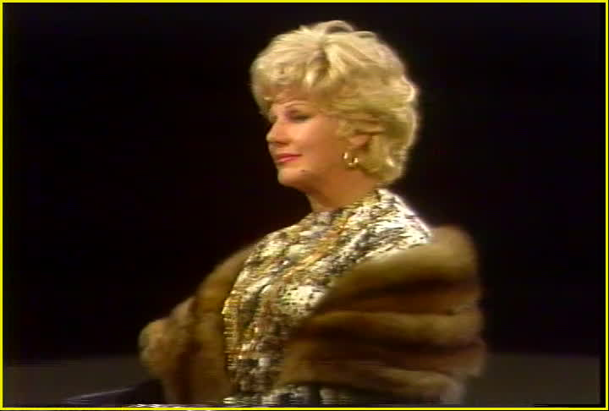
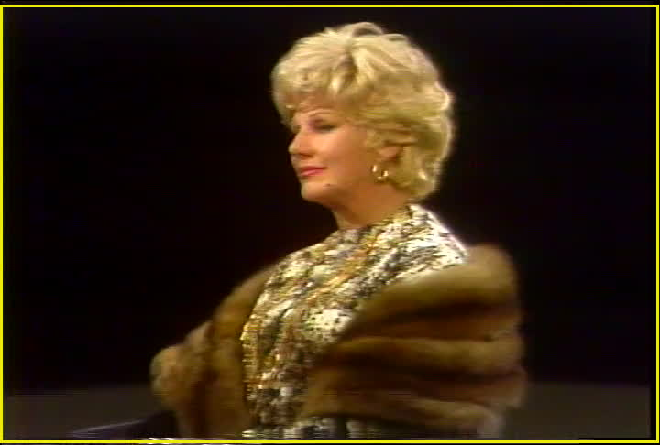
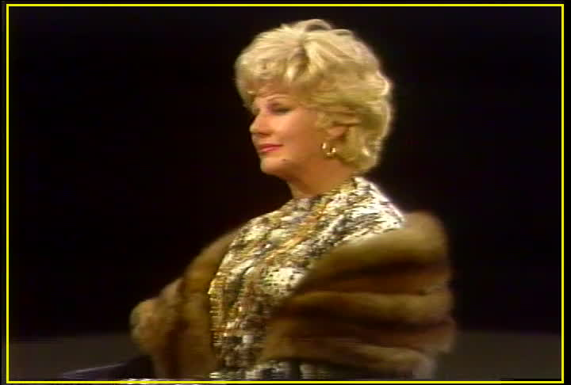

What's 4/3?
720x486
720x480
704x480
710.85x486

Slide 82
 |  | sample aspect ratio width | sample aspect ratio height |  | As decimal
 |  | ( 8 / | 9 ) = |  | 0.88888889
 |  | ( 9 / | 10 ) = |  | 0.9
 |  | ( 10 / | 11 ) = |  | 0.90909091
 |  | ( 4320 / | 4739 ) = |  | 0.91158472

Slide 83


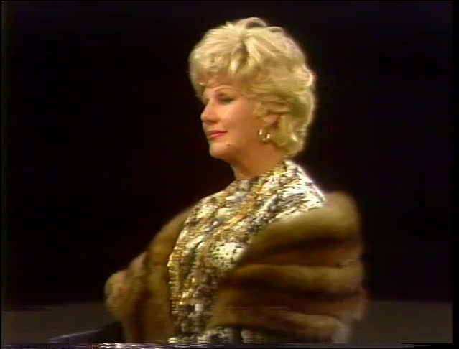
Notes:
10/11 4320/4739
9/10 8/9

Slide 84
10/11
4320/4739
9/10
8/9
Notes:
10/11 4320/4739
9/10 8/9

Slide 85
8/9
9/10
10/11
4320/4739
Notes:
10/11 4320/4739
9/10 8/9

